Slide 1
Chapter 23 Concurrency

Slide 2
Objectives
Understand concurrency, parallelism and multithreading.
Learn the thread life cycle.
Use ExecutorService to launch concurrent threads that execute Runnables.
Use synchronized methods to coordinate access to shared mutable data.
Understand producer/consumer relationships.
Use JavaFX’s concurrency APIs to update GUIs in a thread-safe manner.
Compare the performance of Arrays methods sort and parallelSort on a multi-core system.
Use parallel streams for better performance on multi-core systems.
Use CompletableFutures to execute long calculations asynchronously and get the results in the future.

Slide 3
23.1 Introduction
When we say that two tasks are operating in parallel, we mean that they’re executing simultaneously.
In this sense, parallelism is a subset of concurrency.
Java makes concurrency available to you through the language and APIs.

Slide 4
23.1 Introduction
Multithreading
Provides application with multiple threads of execution
Allows programs to perform tasks concurrently
Often requires programmer to synchronize threads to function correctly

Slide 5
Threads and Processes

Slide 6
23.2 Thread States: Life Cycle of a Thread
new state
A new thread begins its life cycle in this state.
Remains there until started, which places it in the runnable state—considered to be executing its task.
waiting state
A runnable thread can transition to the this state while it waits for another thread to perform a task.
Transitions back to the runnable state only when another thread notifies it to continue executing.

Slide 7
23.2 Thread States: Life Cycle of a Thread (cont.)
timed waiting state
A runnable thread can enter this state for a specified interval of time.
Transitions back to the runnable state when that time interval expires or when the event it’s waiting for occurs.
Cannot use a processor, even if one is available.
blocked state
A runnable thread transitions to this state when it attempts to perform a task that cannot be completed immediately and it must temporarily wait until that task completes.
terminated state
A runnable thread enters this state when it successfully completes its task or otherwise terminates (perhaps due to an error).

Slide 8
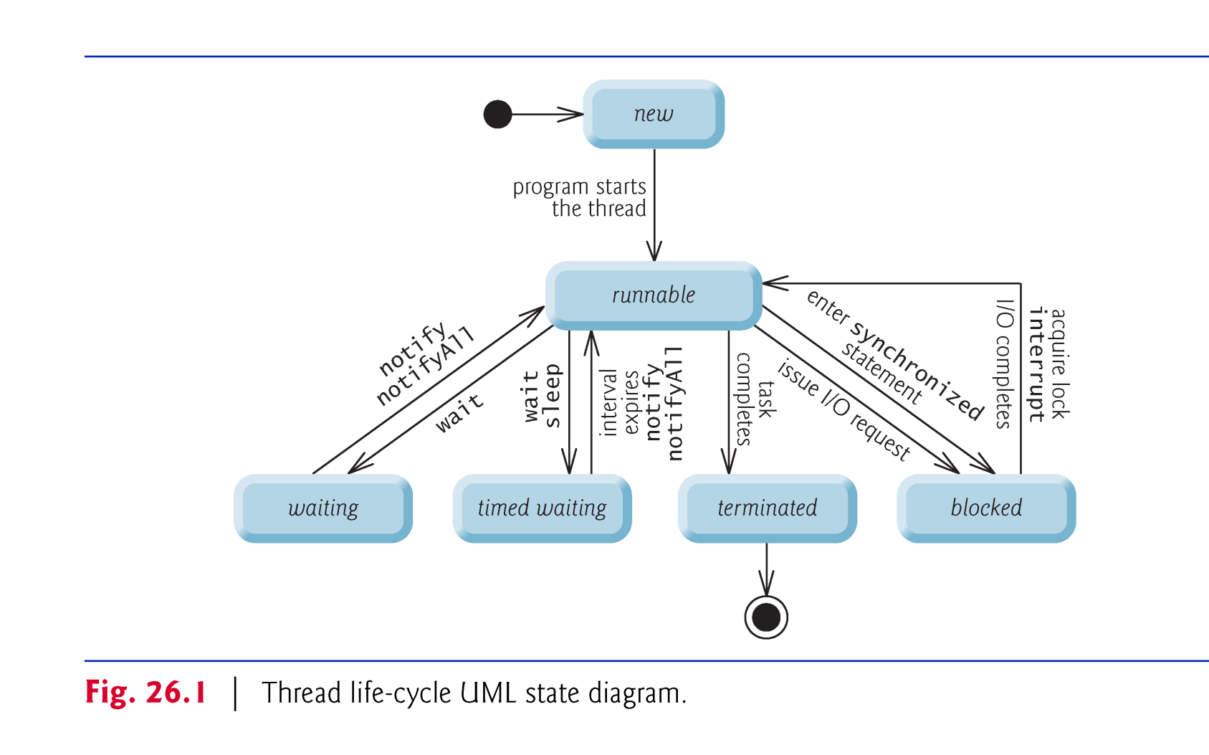

Slide 9
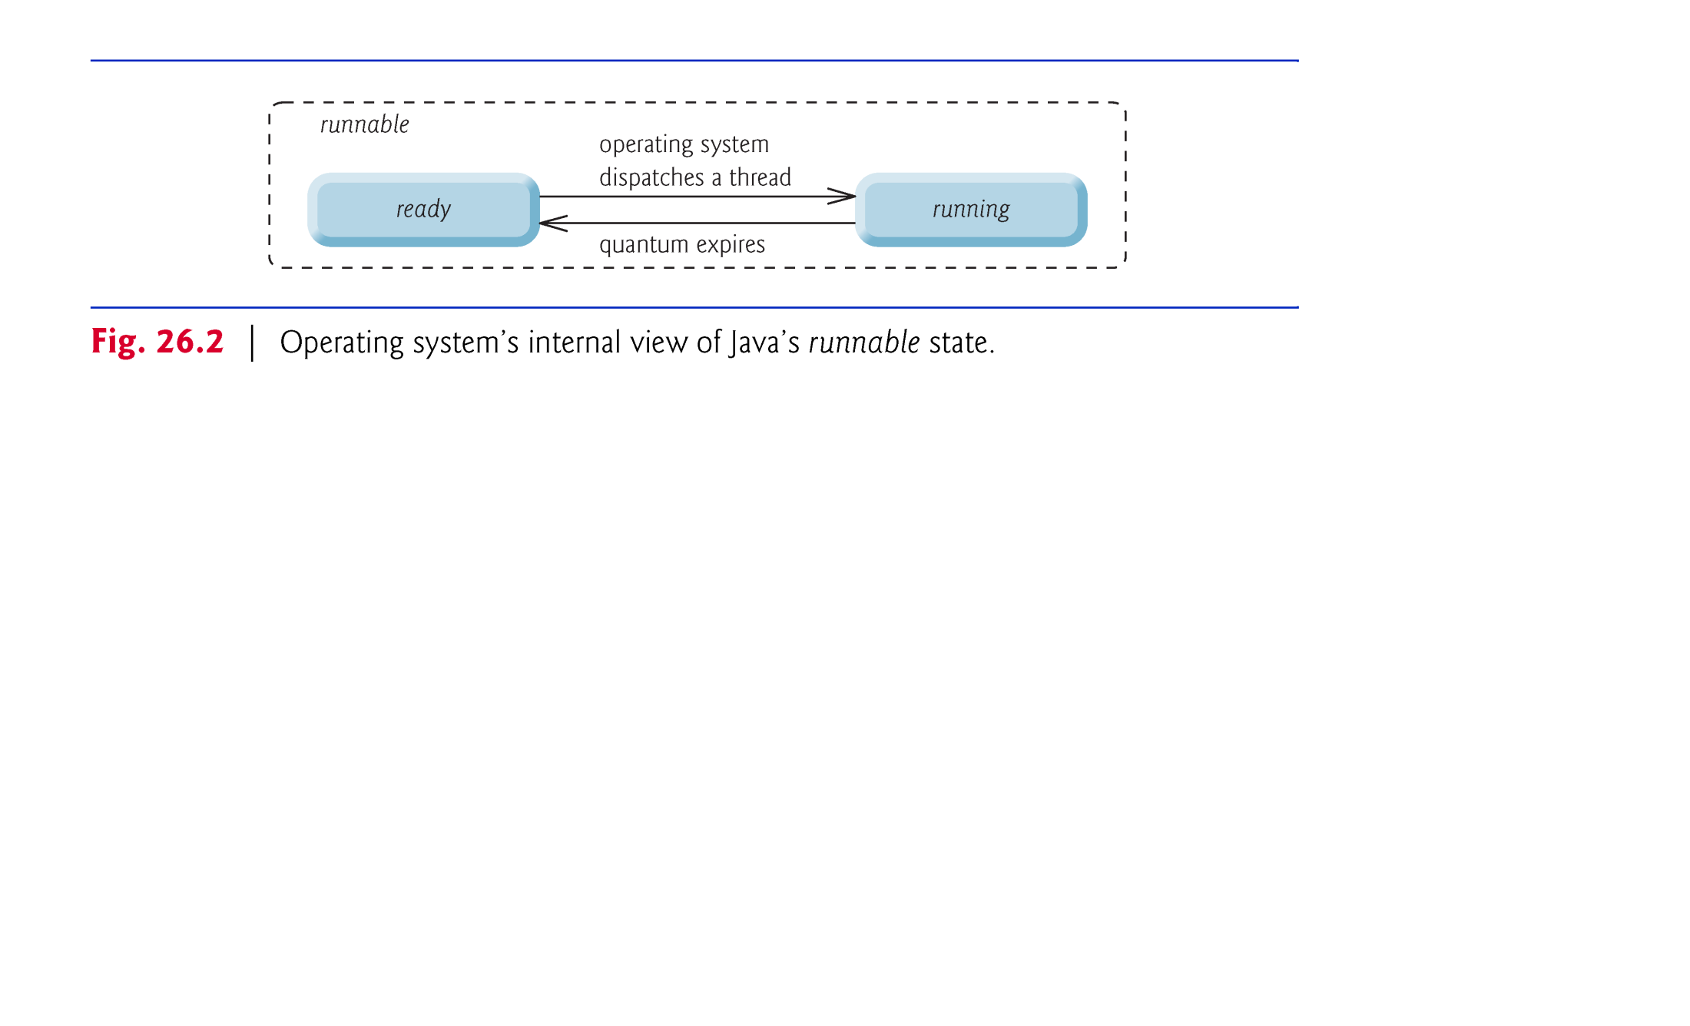

Slide 10
23.2 Thread States: Lifecycle of a Thread (cont.)
Every Java thread has a thread priority that helps determine the order in which threads are scheduled.
Thread priorities cannot guarantee the order in which threads execute.
Java priorities are in the range between MIN_PRIORITY (a constant of 1) and MAX_PRIORITY (a constant of 10)
Threads with a higher priority are more important and will be allocated a processor before threads with a lower priority
Default priority is NORM_PRIORITY (a constant of 5)

Slide 11
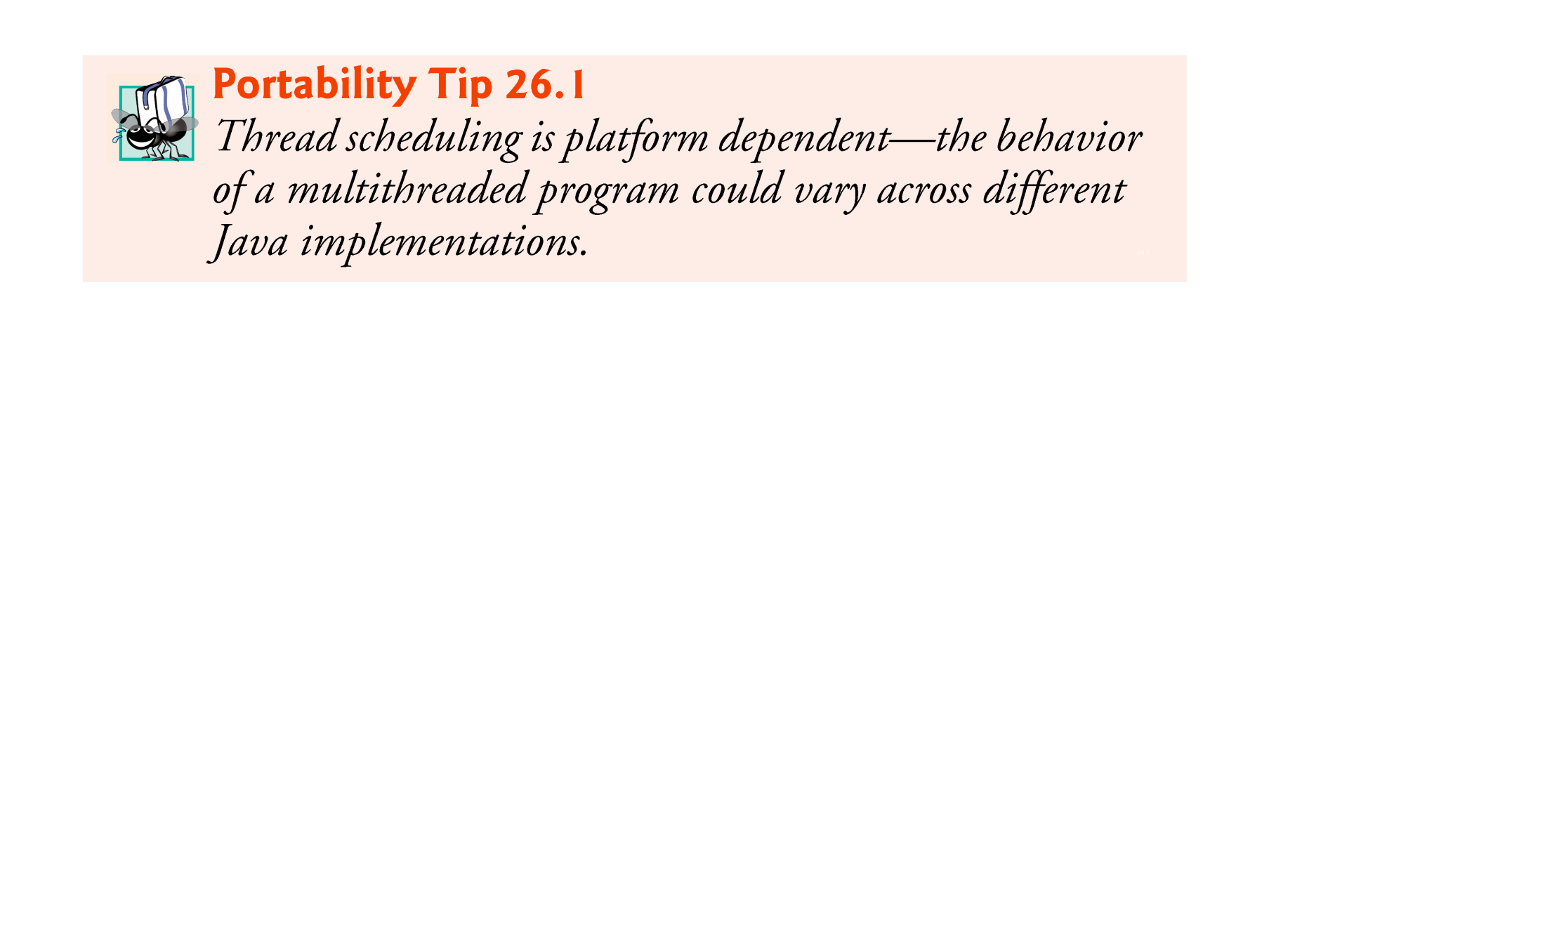

Slide 12
23.3 Creating and Executing Threads with Executor Framework
Runnable interface
Preferred means of creating a multithreaded application
Declares method run
Executed by an object that implements the Executor interface
Executor interface
Declares method execute
Creates and manages a group of threads called a thread pool

Slide 13
23.3 Creating and Executing Threads with Executor Framework(cont.)
ExecutorService interface
Subinterface of Executor that declares other methods for managing the life cycle of an Executor
Can be created using static methods of class Executors
Method shutdown ends threads when tasks are completed
Executors class
Method newFixedThreadPool creates a pool consisting of a fixed number of threads
Method newCachedThreadPool creates a pool that creates new threads as they are needed

Slide 14
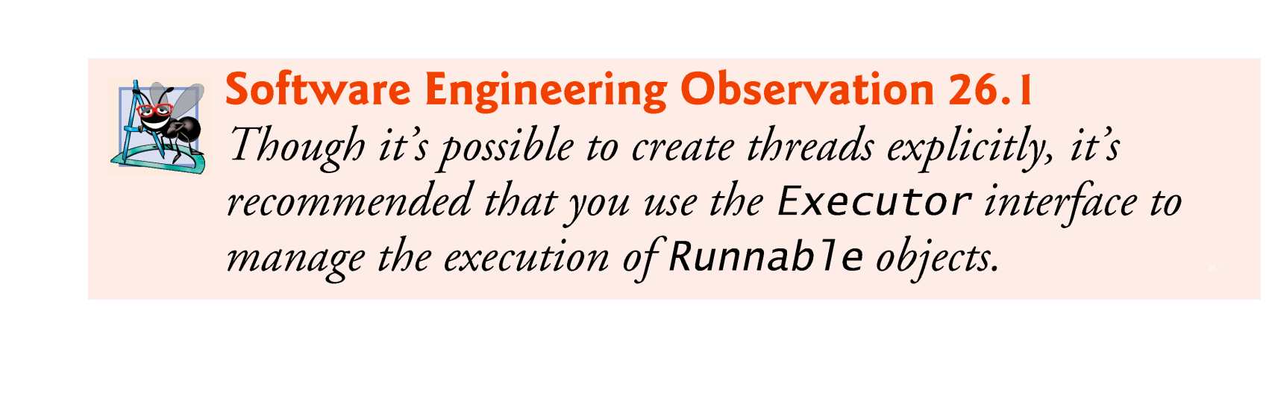

Slide 15
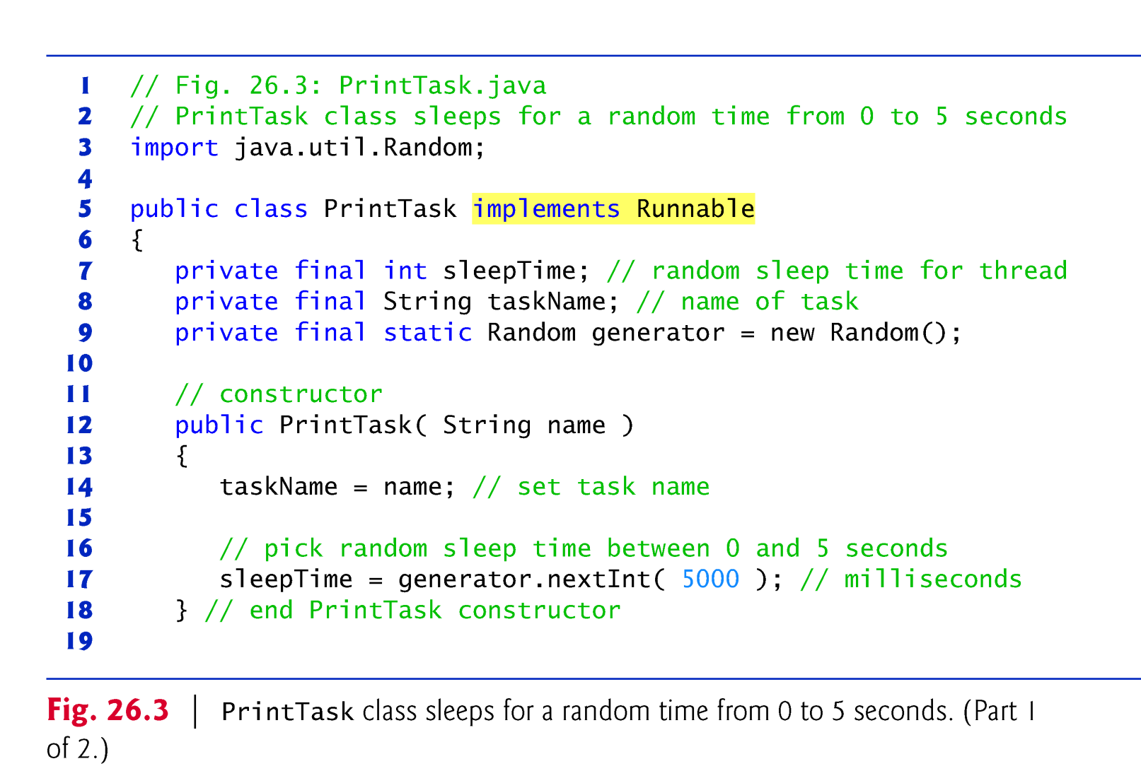

Slide 16
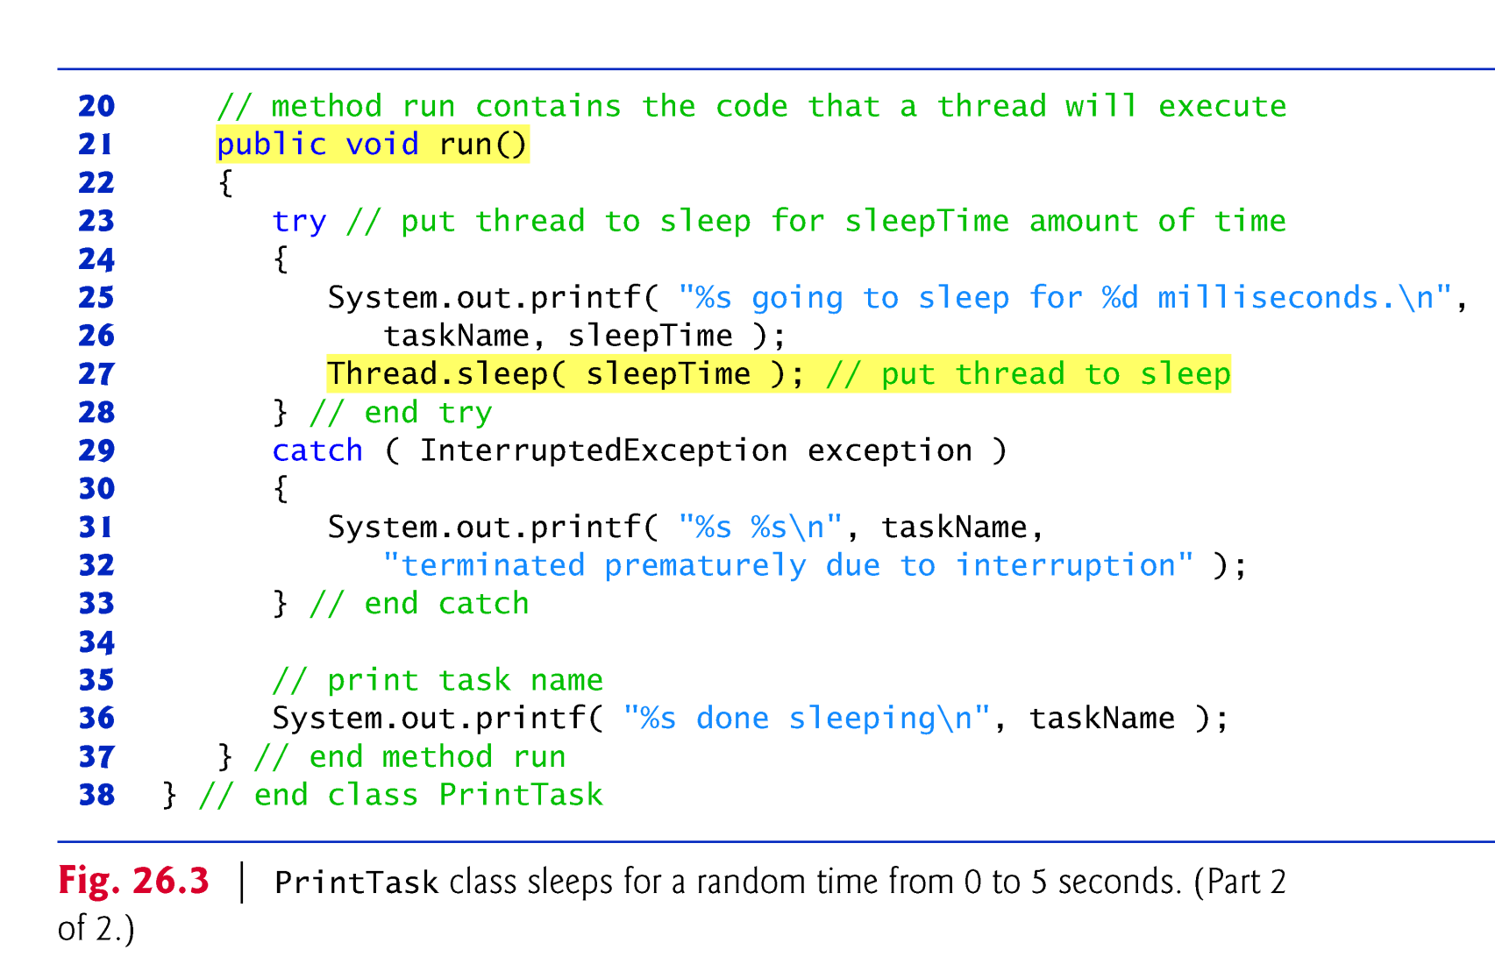

Slide 17
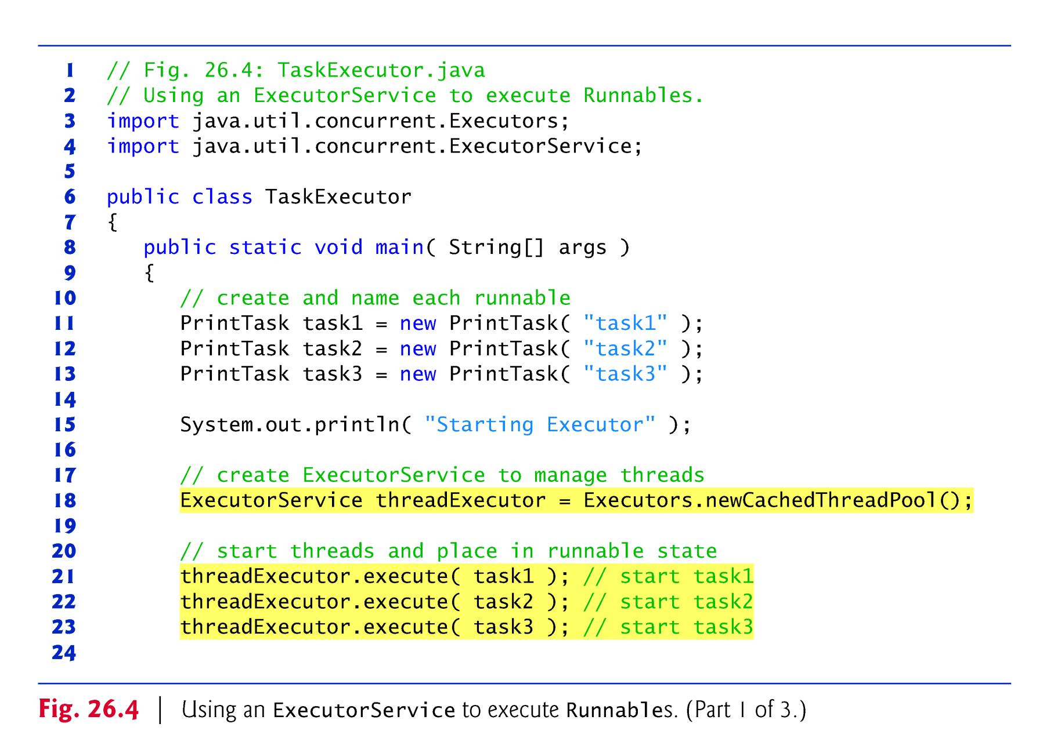

Slide 18
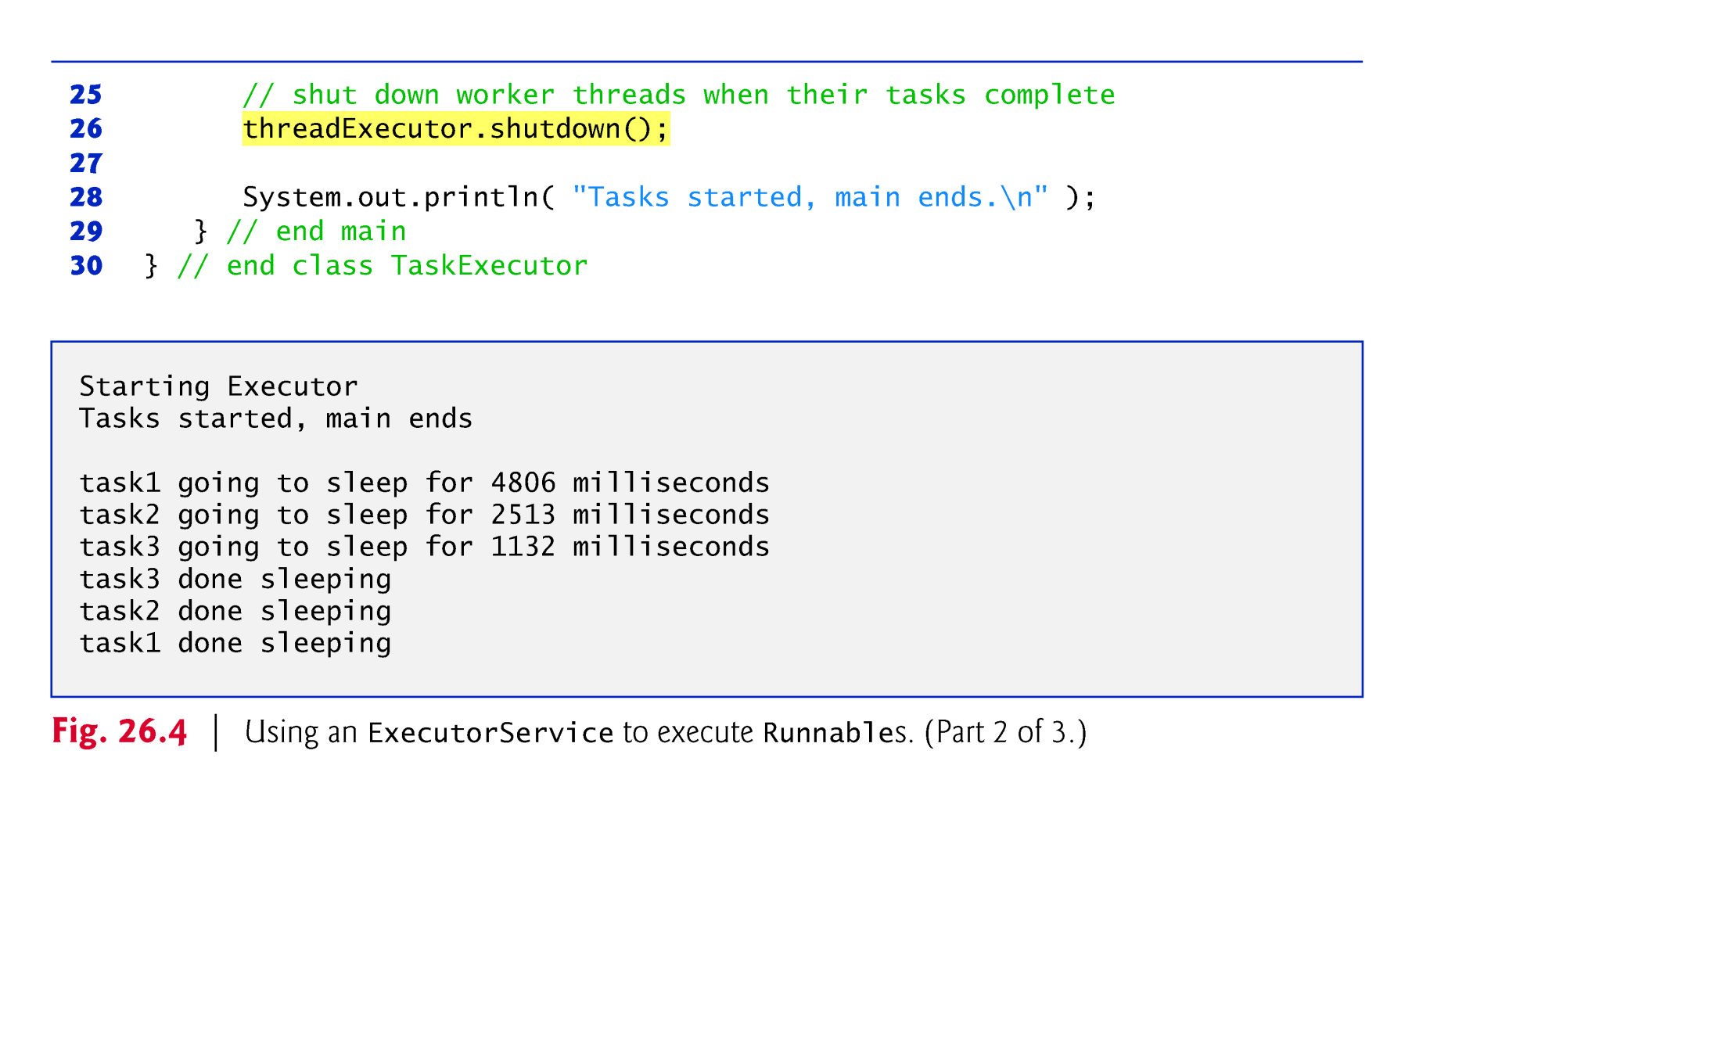

Slide 19
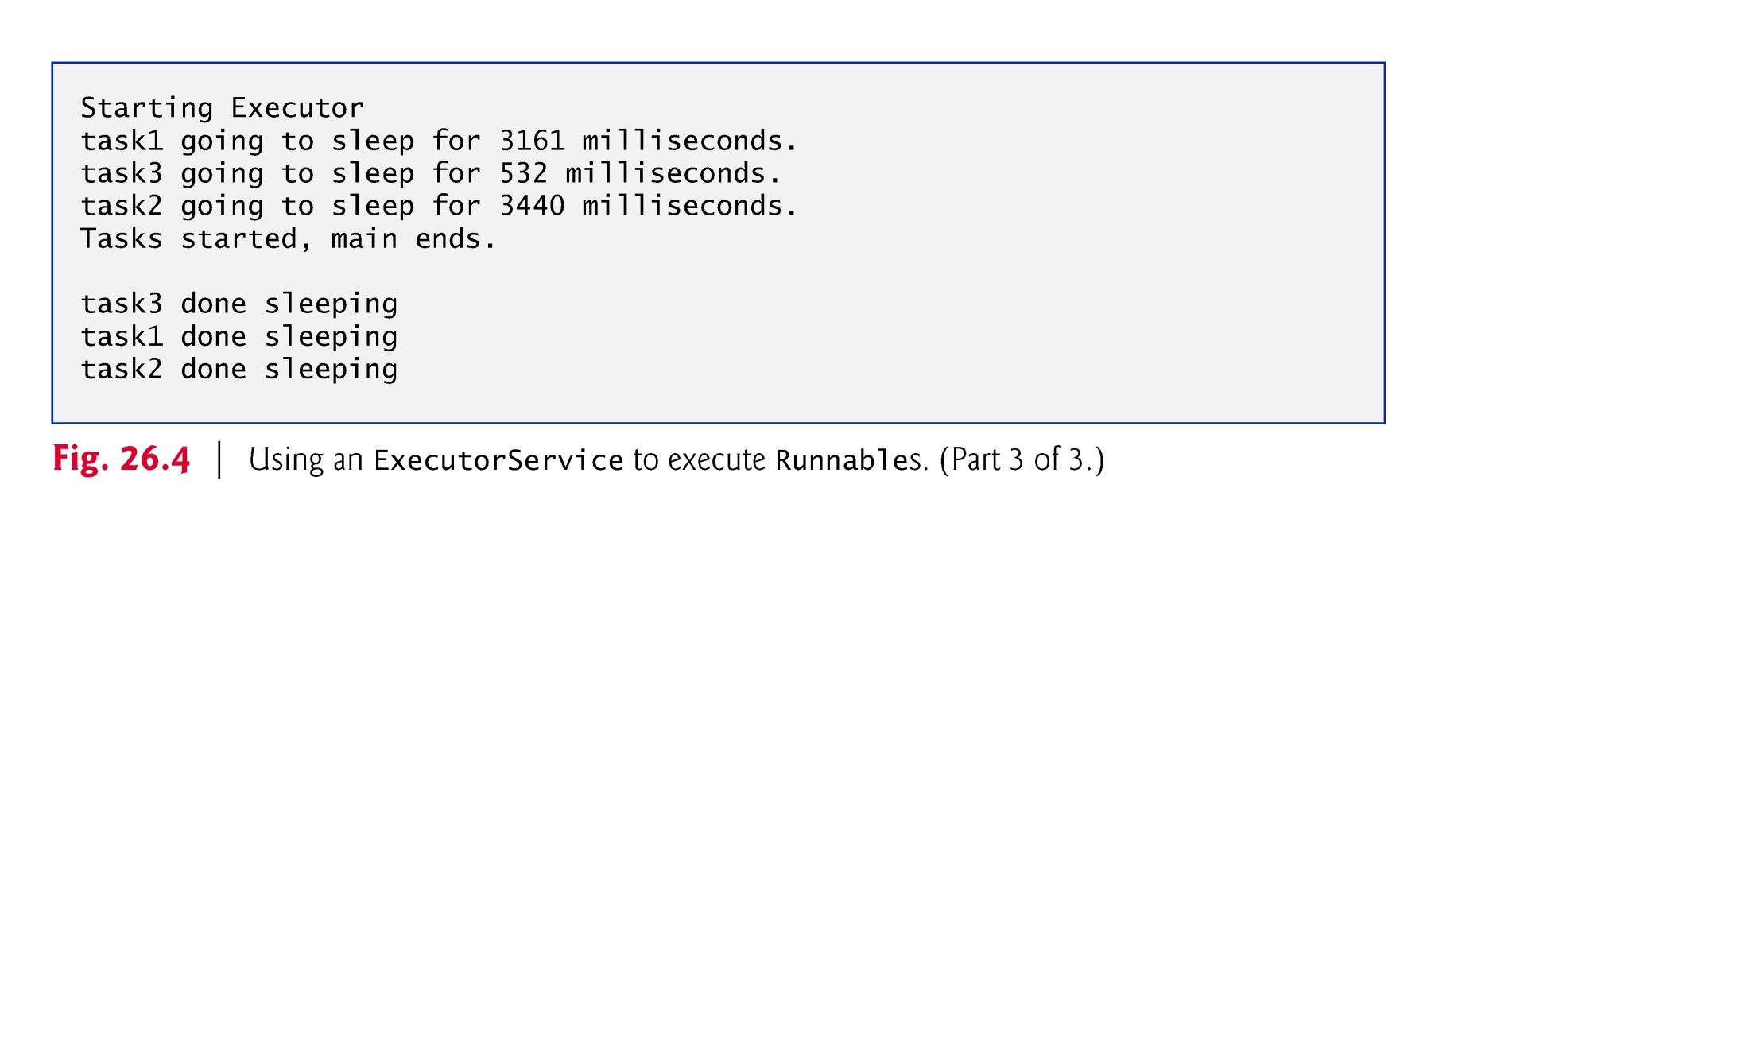

Slide 20
23.4 Thread Synchronization
Thread synchronization
Provided to the programmer with mutual exclusion(互斥)
Exclusive access to a shared object，during that time, other threads desiring to access the object are kept waiting.
Implemented in Java using locks
Lock interface
lock method obtains the lock, enforcing mutual exclusion
unlock method releases the lock
Class implements the Lock interface

Slide 21
Immutable Data
Actually, thread synchronization is necessary only for shared mutable data,
When you share immutable data across threads, declare the corresponding data fields final to indicate that the values of the variables will not change after they’re initialized

Slide 22
23.4 Thread Synchronization (cont.)
The synchronized statements are declared using the synchronized keyword:
synchronized ( object ) { statements } // end synchronized statement
where object is the object whose monitor lock will be acquired
object is normally this if it’s the object in which the synchronized statement appears.
When a synchronized statement finishes executing, the object’s monitor lock is released.
Java also allows synchronized methods.

Slide 23
A SimpleArray object (Fig. 23.5) will be shared across multiple threads.
Will enable those threads to place int values into array.
Line 26 puts the thread that invokes add to sleep for a random interval from 0 to 499 milliseconds.
This is done to make the problems associated with unsynchronized access to shared data more obvious.

Slide 24
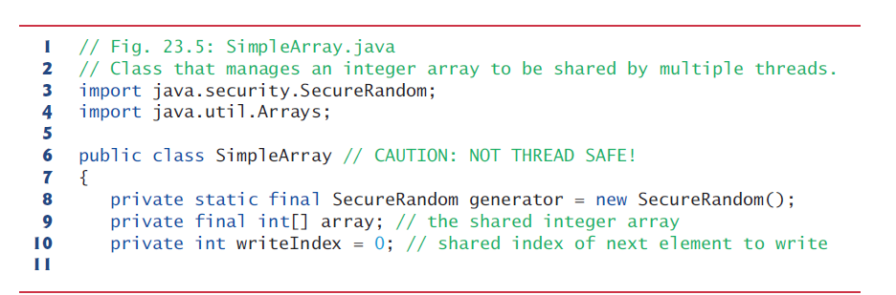
23.4.1 Unsynchronized Data Sharing
SimpleArray is not thread safe because it allows any number of threads to read and modify shared mutable data concurrently, which can cause errors

Slide 25
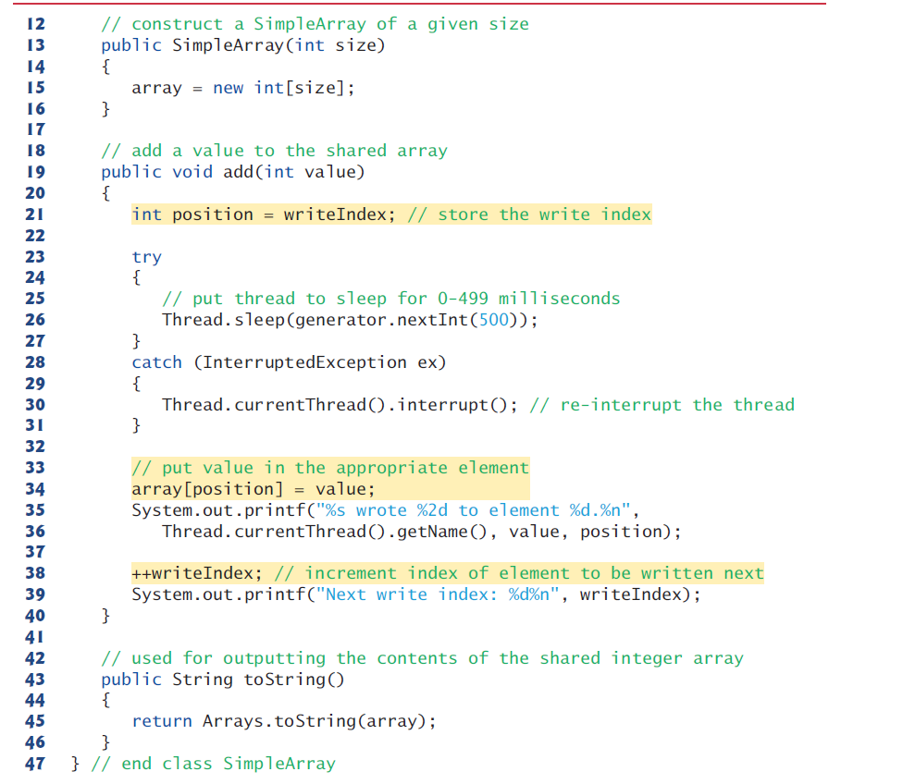

Slide 26
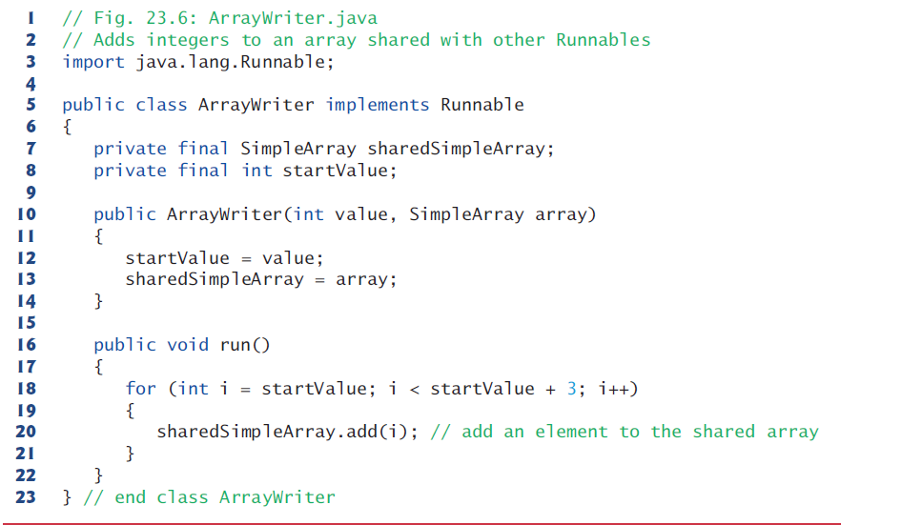

Slide 27
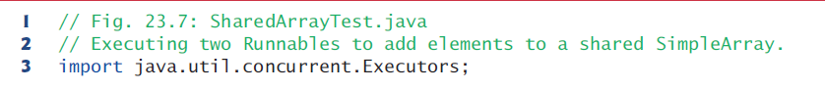
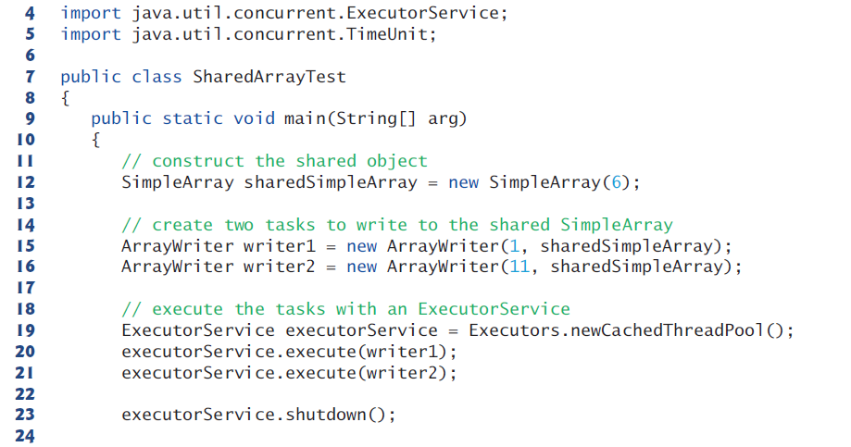

Slide 28
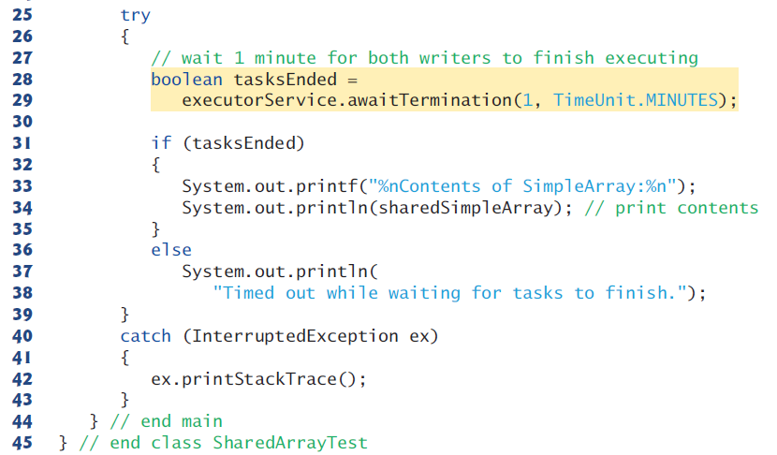
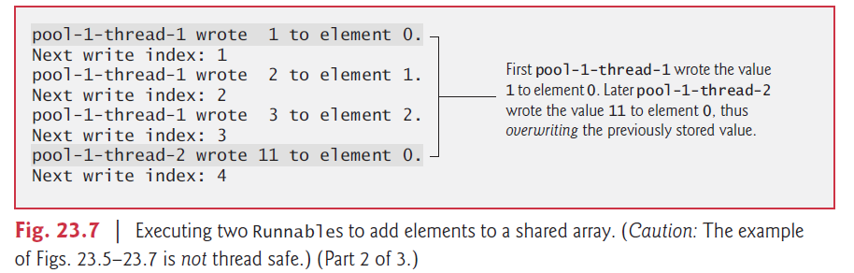

Slide 29
Interface ExecutorService
shutdown()
Initiates an orderly shutdown in which previously submitted tasks are executed, but no new tasks will be accepted.
awaitTermination(long timeout, TimeUnit unit)
Blocks until all tasks have completed execution after a shutdown request, or the timeout occurs, or the current thread is interrupted, whichever happens first.

Slide 30
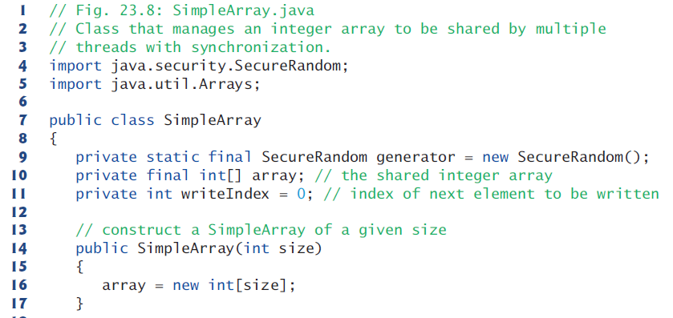
Class SimpleArray with Synchronization

Slide 31
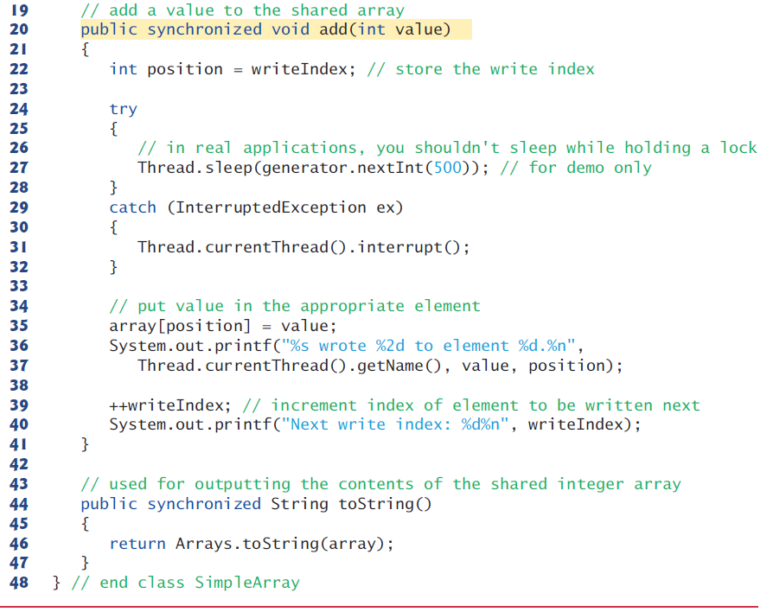

Slide 32
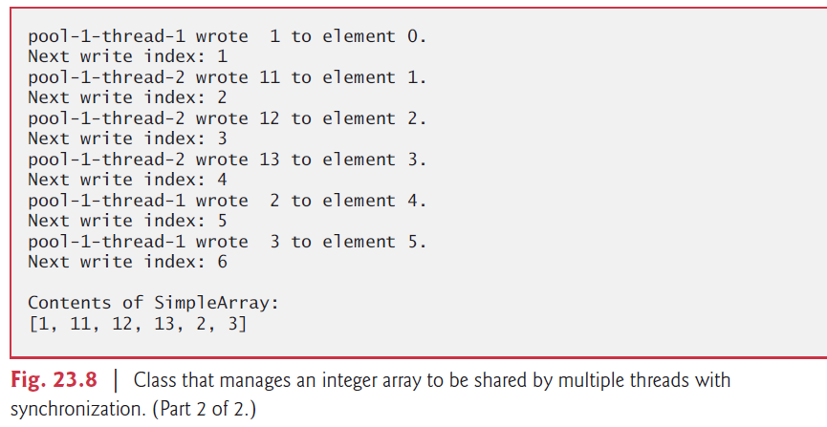

Slide 33
Synchronization is necessary only for mutable data, or data that may change in its lifetime.
Labeling object references as final indicates that the reference will not change, but it does not guarantee that the object itself is immutable—this depends entirely on the object’s properties.

Slide 34
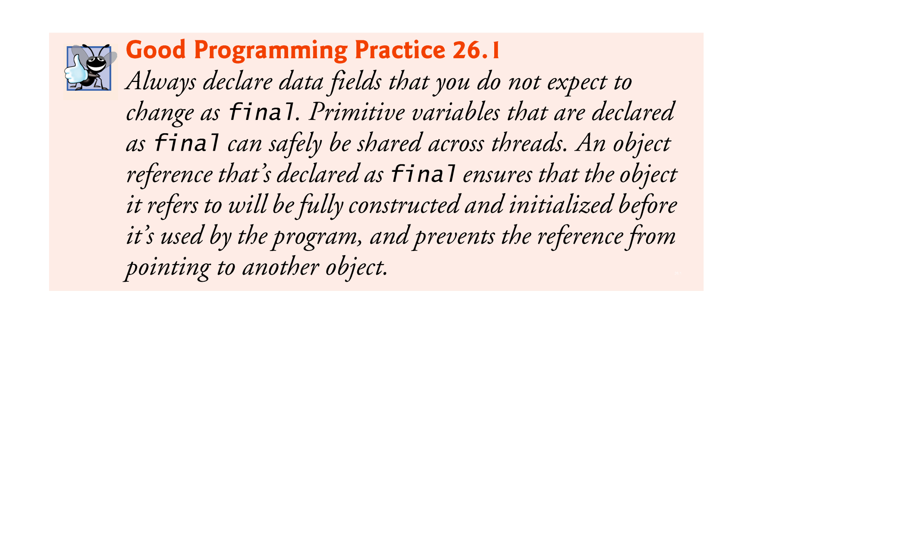

Slide 35
23.5 Producer/Consumer Relationship without Synchronization
In a producer/consumer relationship, the producer portion of an application generates data and stores it in a shared object, and the consumer portion of the application reads data from the shared object.
A producer thread generates data and places it in a shared object called a buffer.
A consumer thread reads data from the buffer.
This relationship requires synchronization to ensure that values are produced and consumed properly.
Operations on the buffer data shared by a producer and consumer thread are also state dependent—the operations should proceed only if the buffer is in the correct state.
If the buffer is in a not-full state, the producer may produce; if the buffer is in a not-empty state, the consumer may consume.

Slide 36
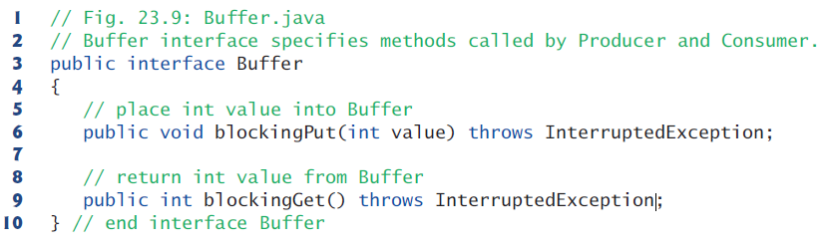

Slide 37
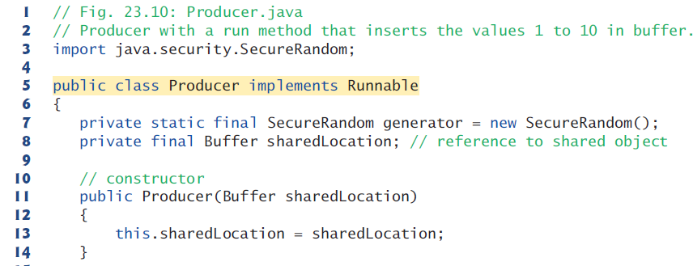

Slide 38
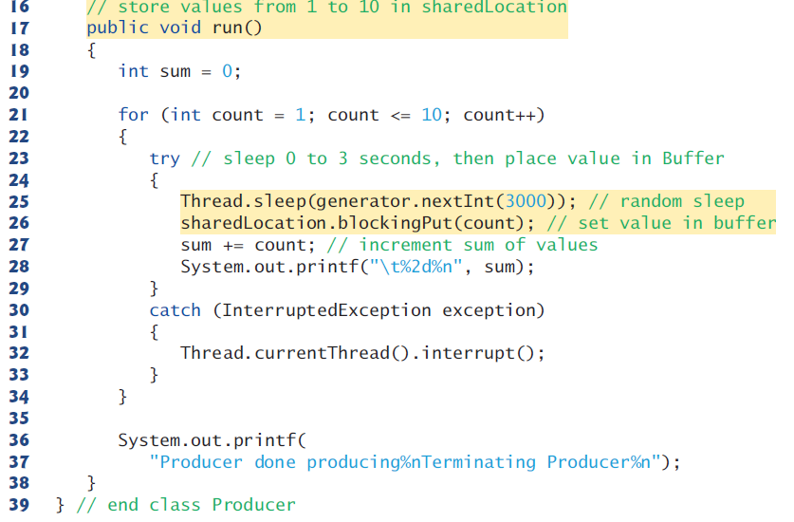

Slide 39
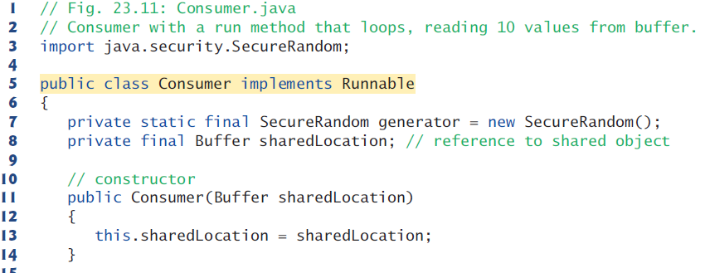

Slide 40
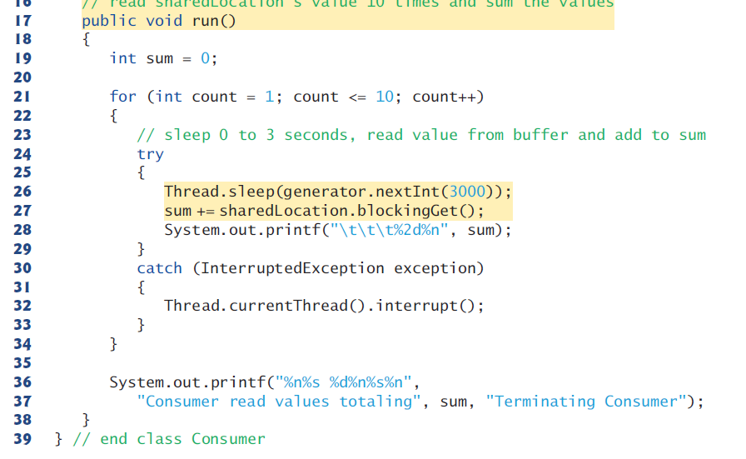

Slide 41
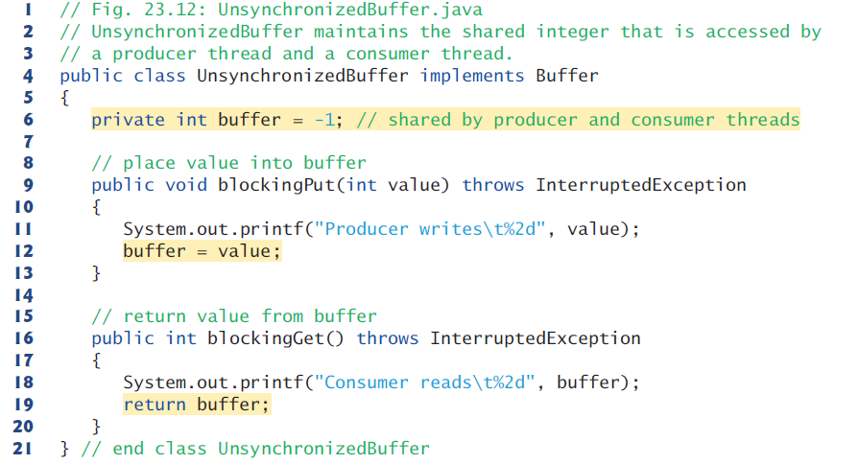

Slide 42
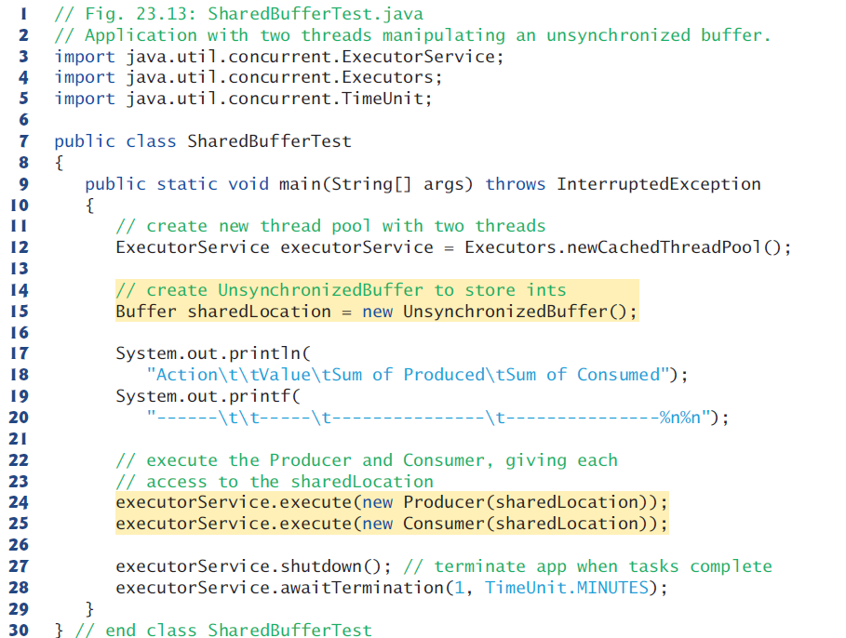

Slide 43
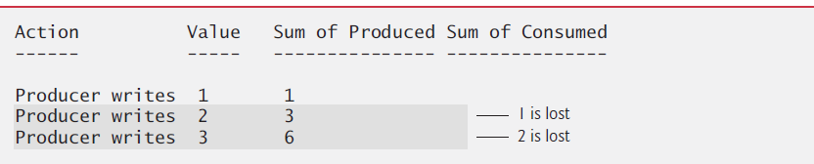
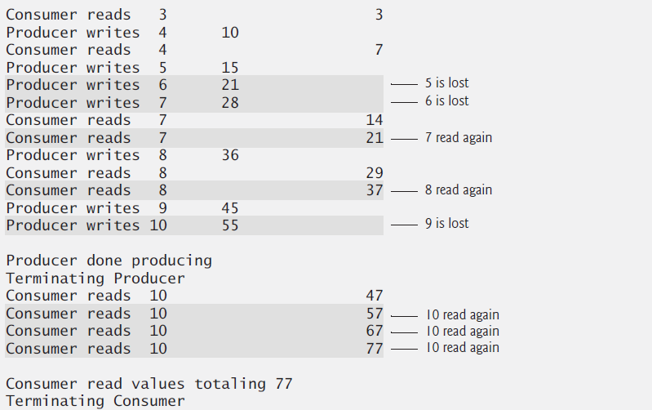

Slide 44
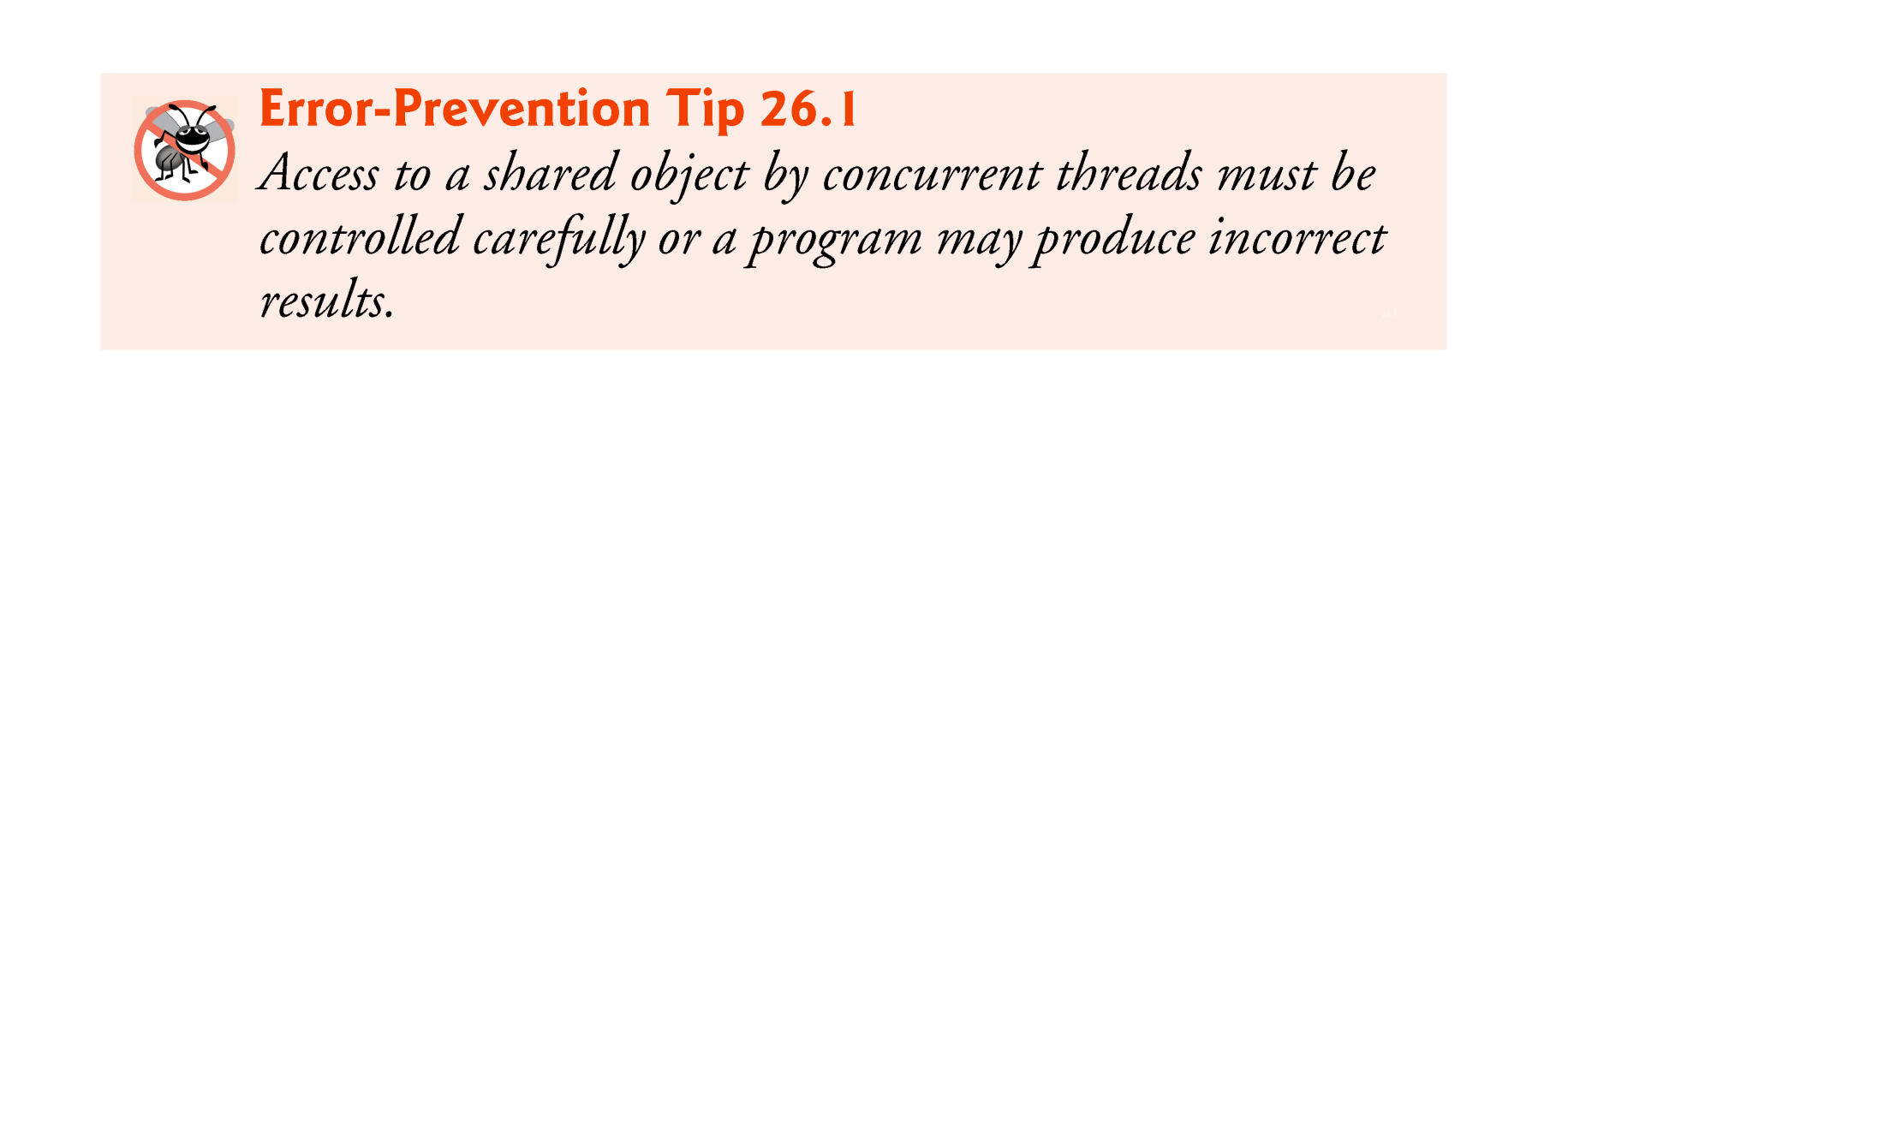

Slide 45
23.6 Producer/Consumer Relationship: ArrayBlockingQueue
One way to synchronize producer and consumer threads is to use classes from Java’s concurrency package that encapsulate the synchronization for you.
Java includes the class ArrayBlockingQueue- (from package java.util.concurrent)—a fully implemented, thread-safe buffer class that implements interface BlockingQueue.
Declares methods put and take, the blocking equivalents of Queue methods offer and poll, respectively.
Method put places an element at the end of the BlockingQueue, waiting if the queue is full.
Method take removes an element from the head of the BlockingQueue, waiting if the queue is empty.

Slide 46
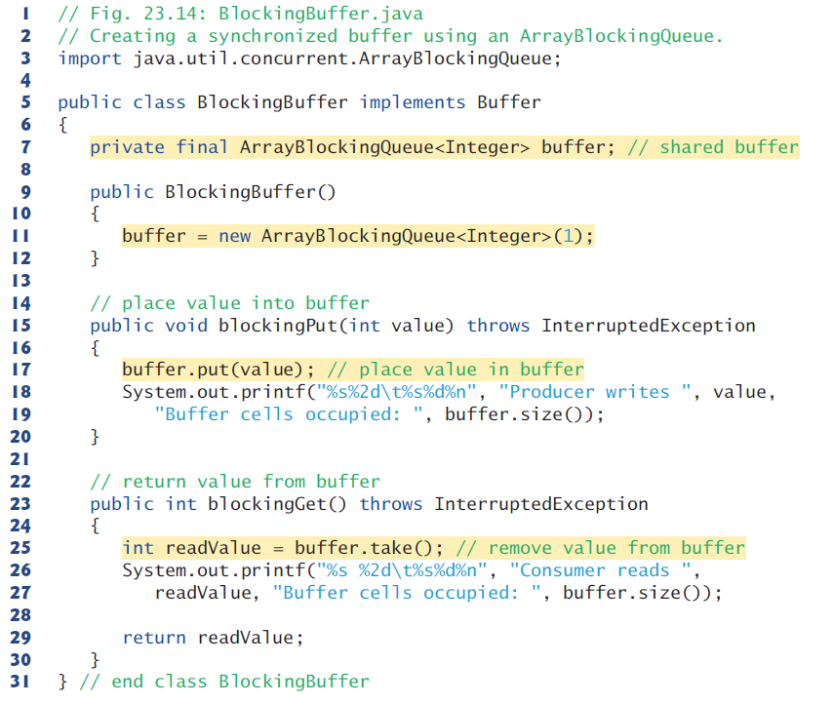

Slide 47
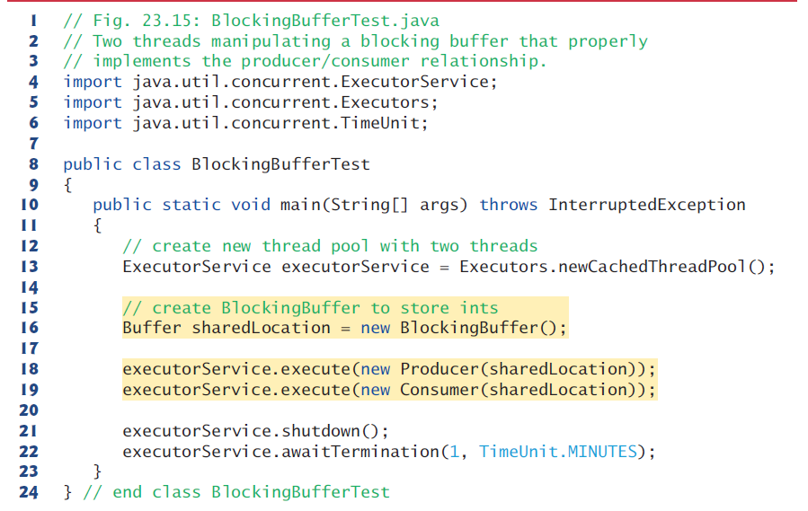

Slide 48
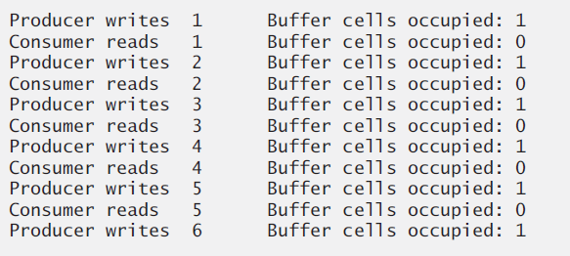

Slide 49
23.7 Producer/Consumer Relationship with Synchronization
For educational purposes, we now explain how you can implement a shared buffer yourself using the synchronized keyword and methods of class Object.
The first step in synchronizing access to the buffer is to implement methods get and set as synchronized methods.
This requires that a thread obtain the monitor lock on the Buffer object before attempting to access the buffer data.

Slide 50
23.7 Producer/Consumer Relationship with Synchronization (cont.)
Object methods wait, notify and notifyAll can be used with conditions to make threads wait when they cannot perform their tasks.
Calling Object method wait on a synchronized object releases its monitor lock, and places the calling thread in the waiting state.
Call Object method notify on a synchronized object allows a waiting thread to transition to the runnable state again.
If a thread calls notifyAll on the synchronized object, then all the threads waiting for the monitor lock become eligible to reacquire the lock.

Slide 51
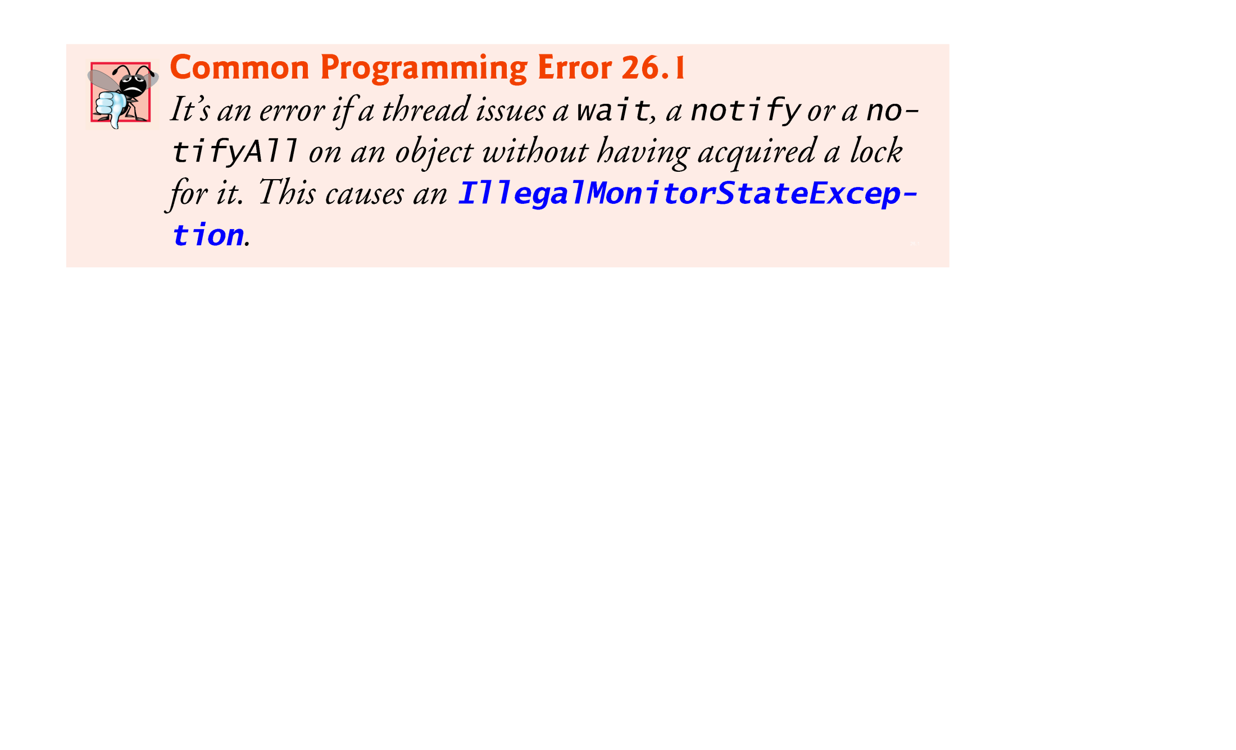

Slide 52
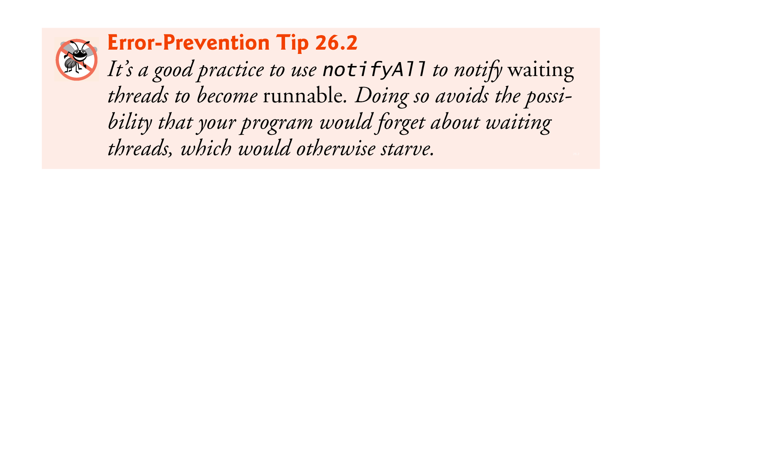

Slide 53
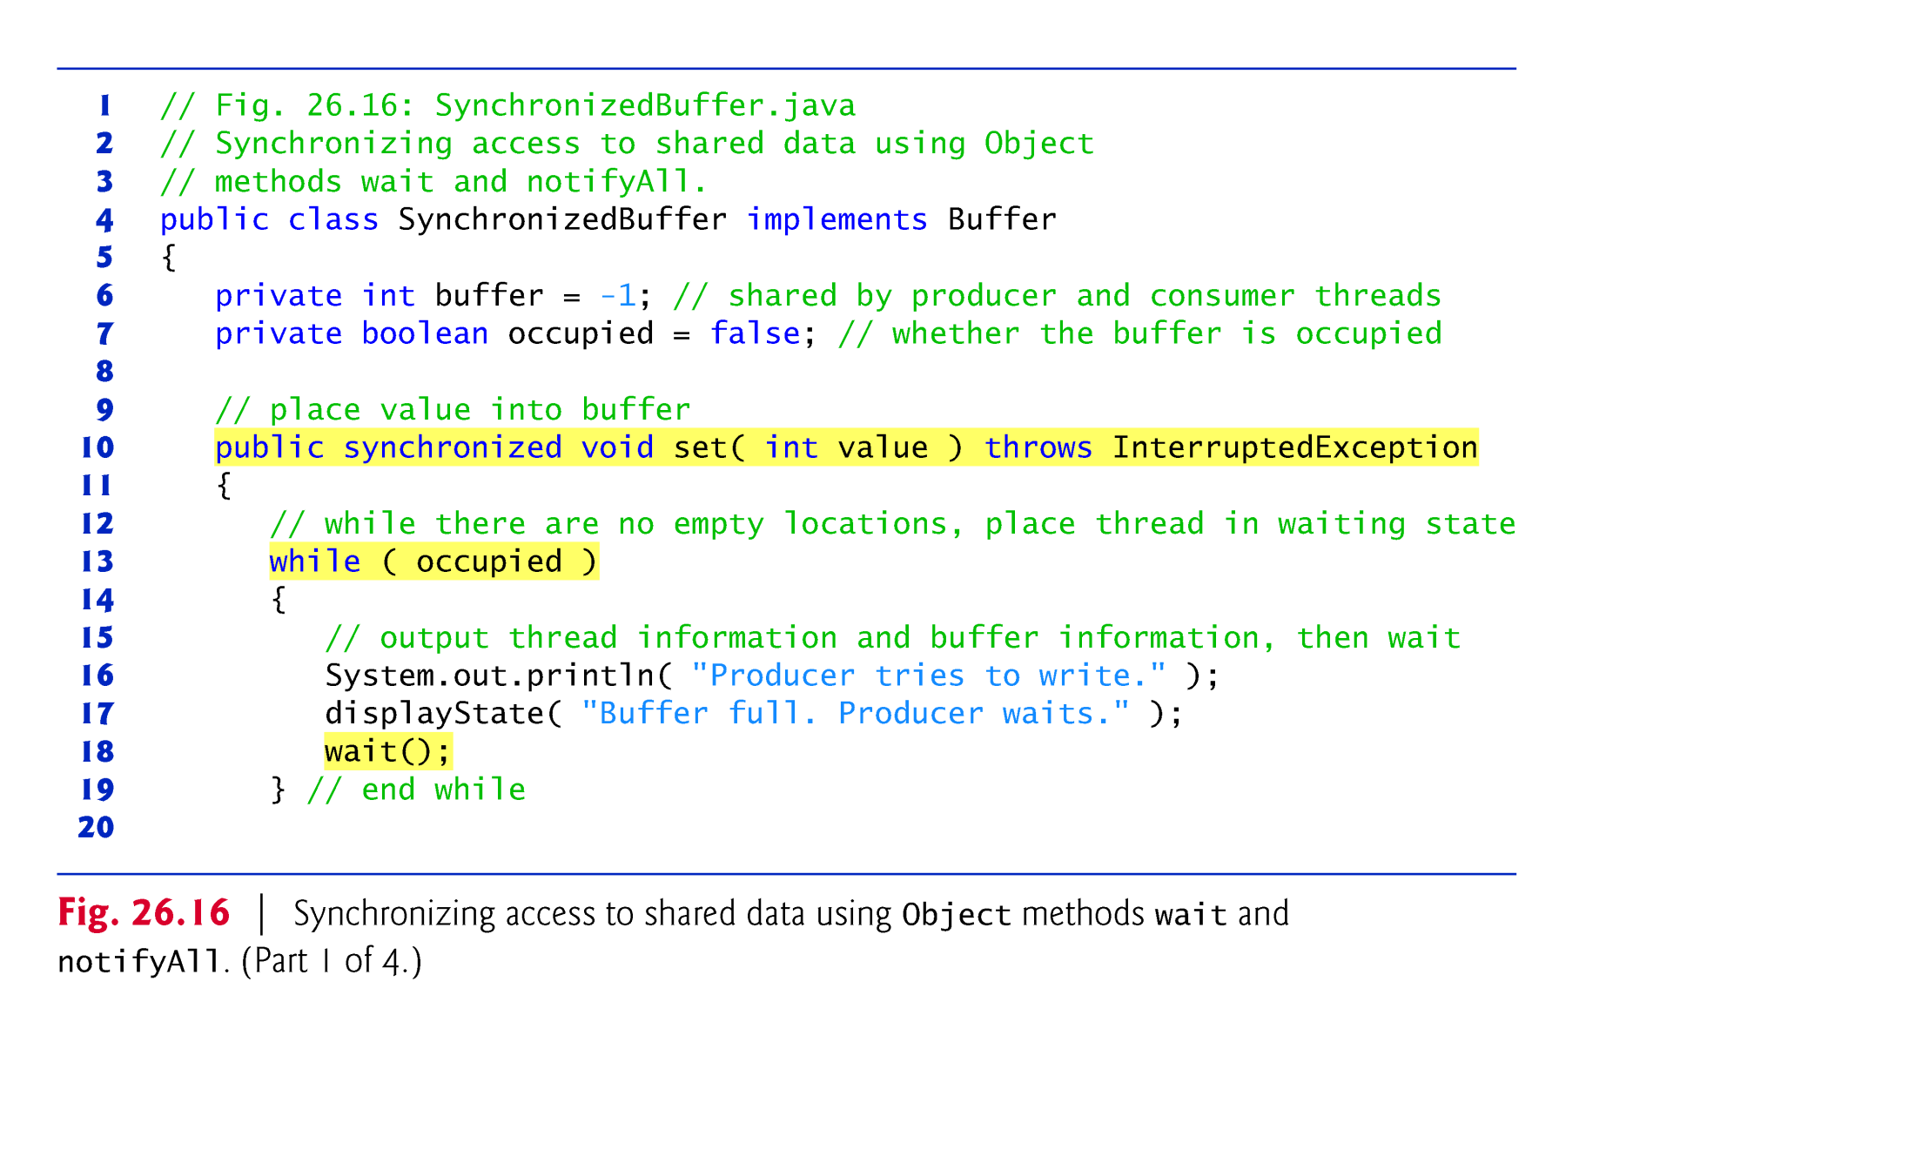

Slide 54
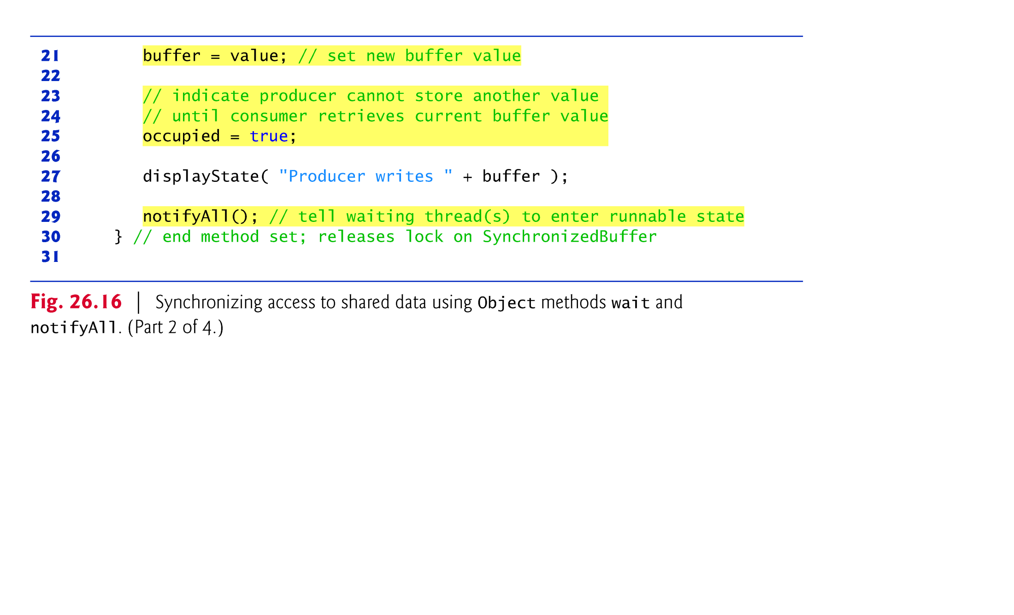

Slide 55
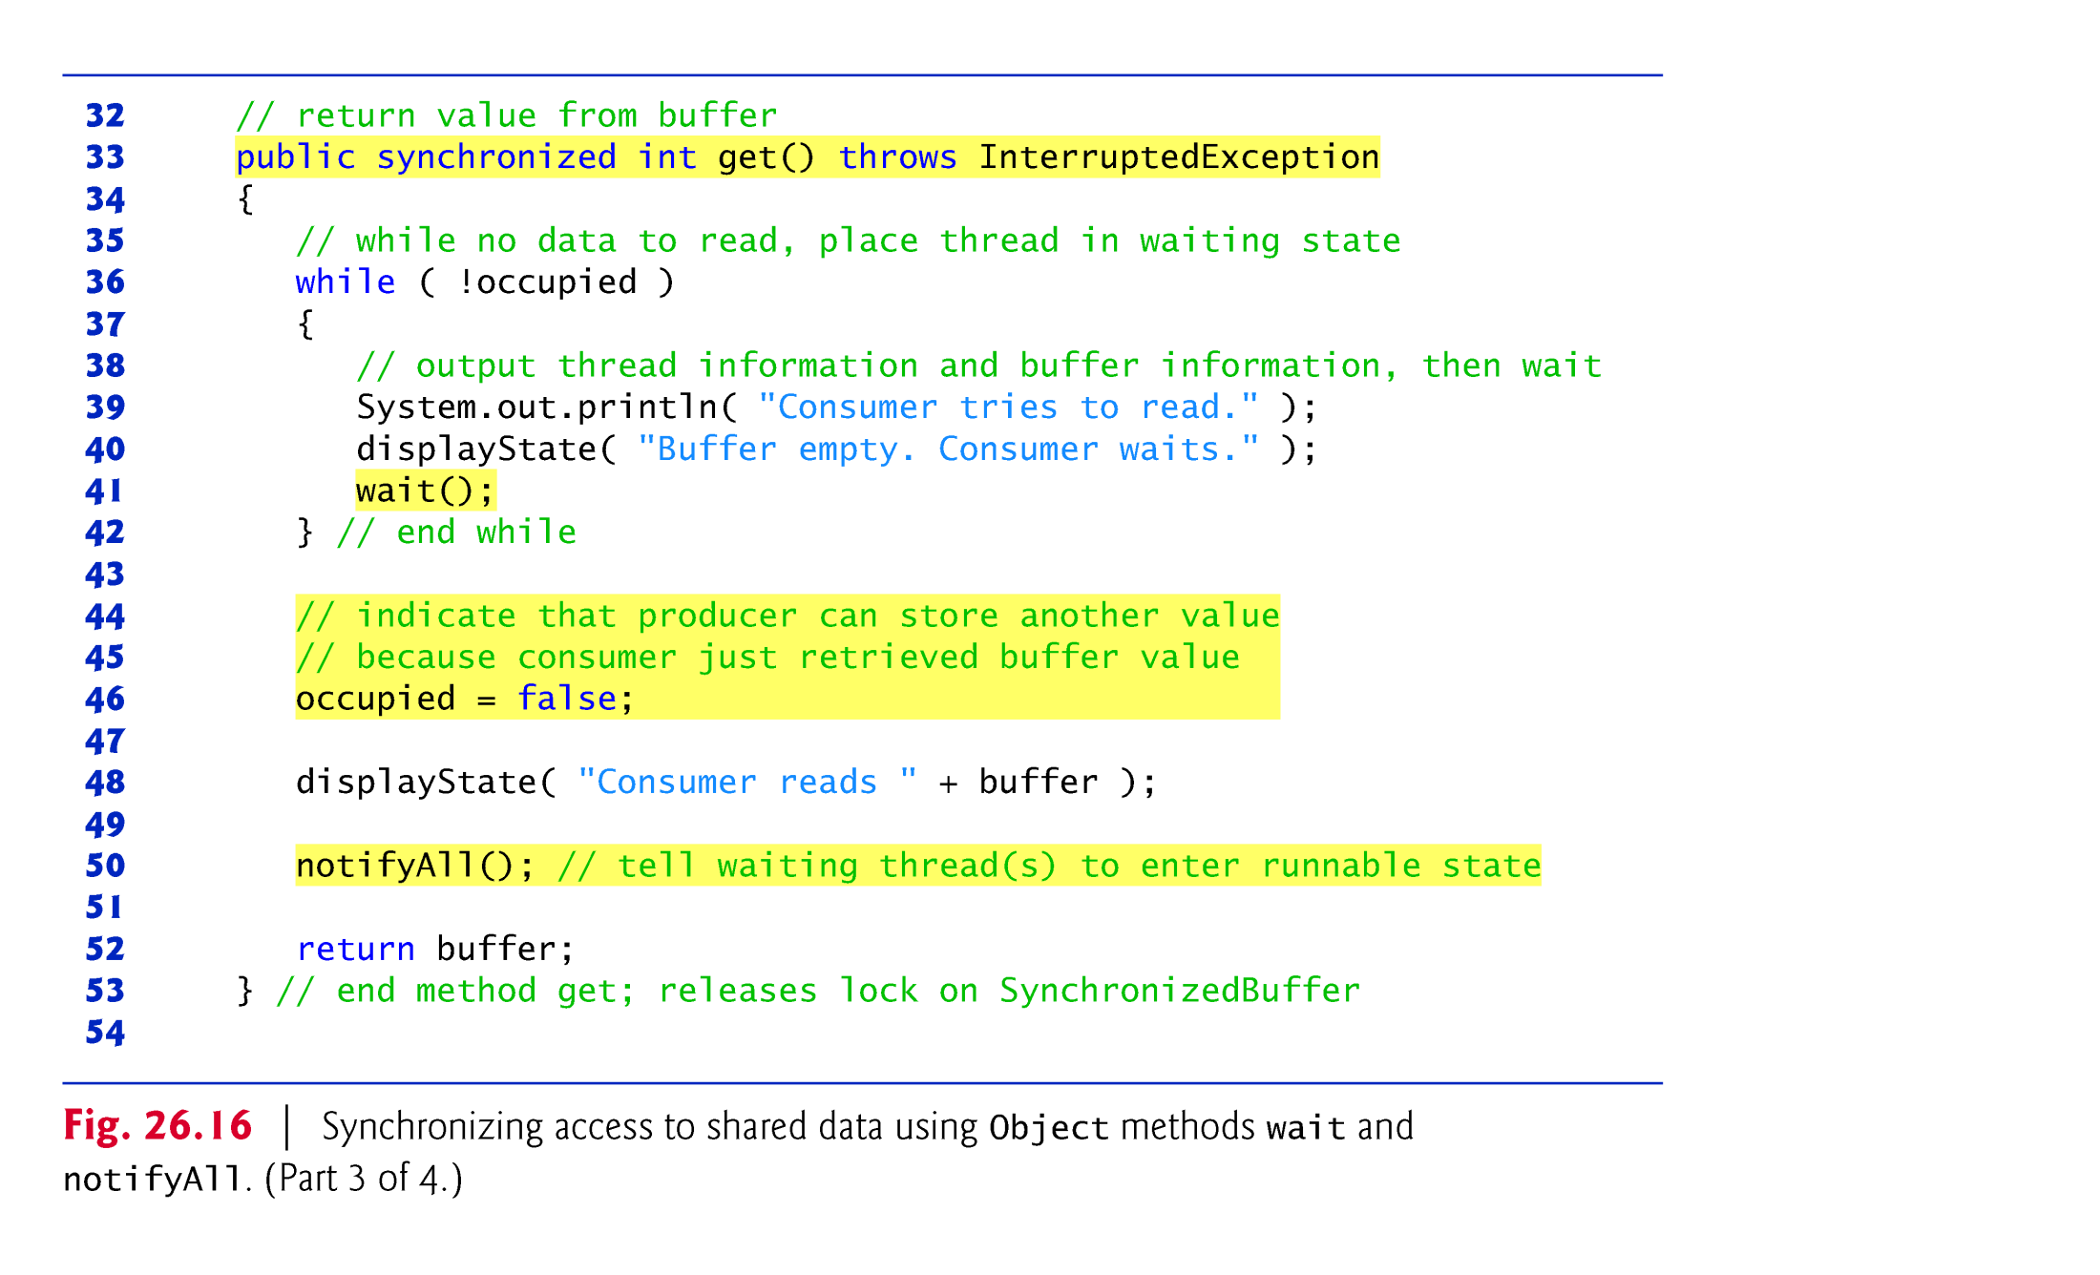

Slide 56
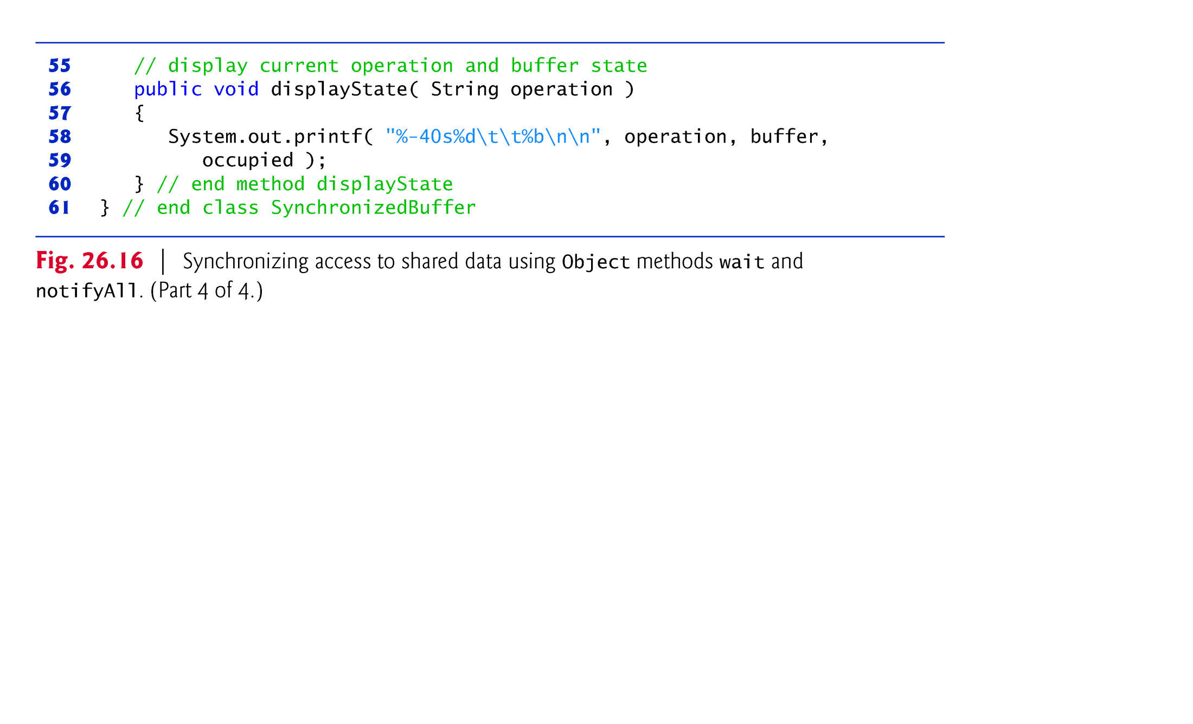

Slide 57
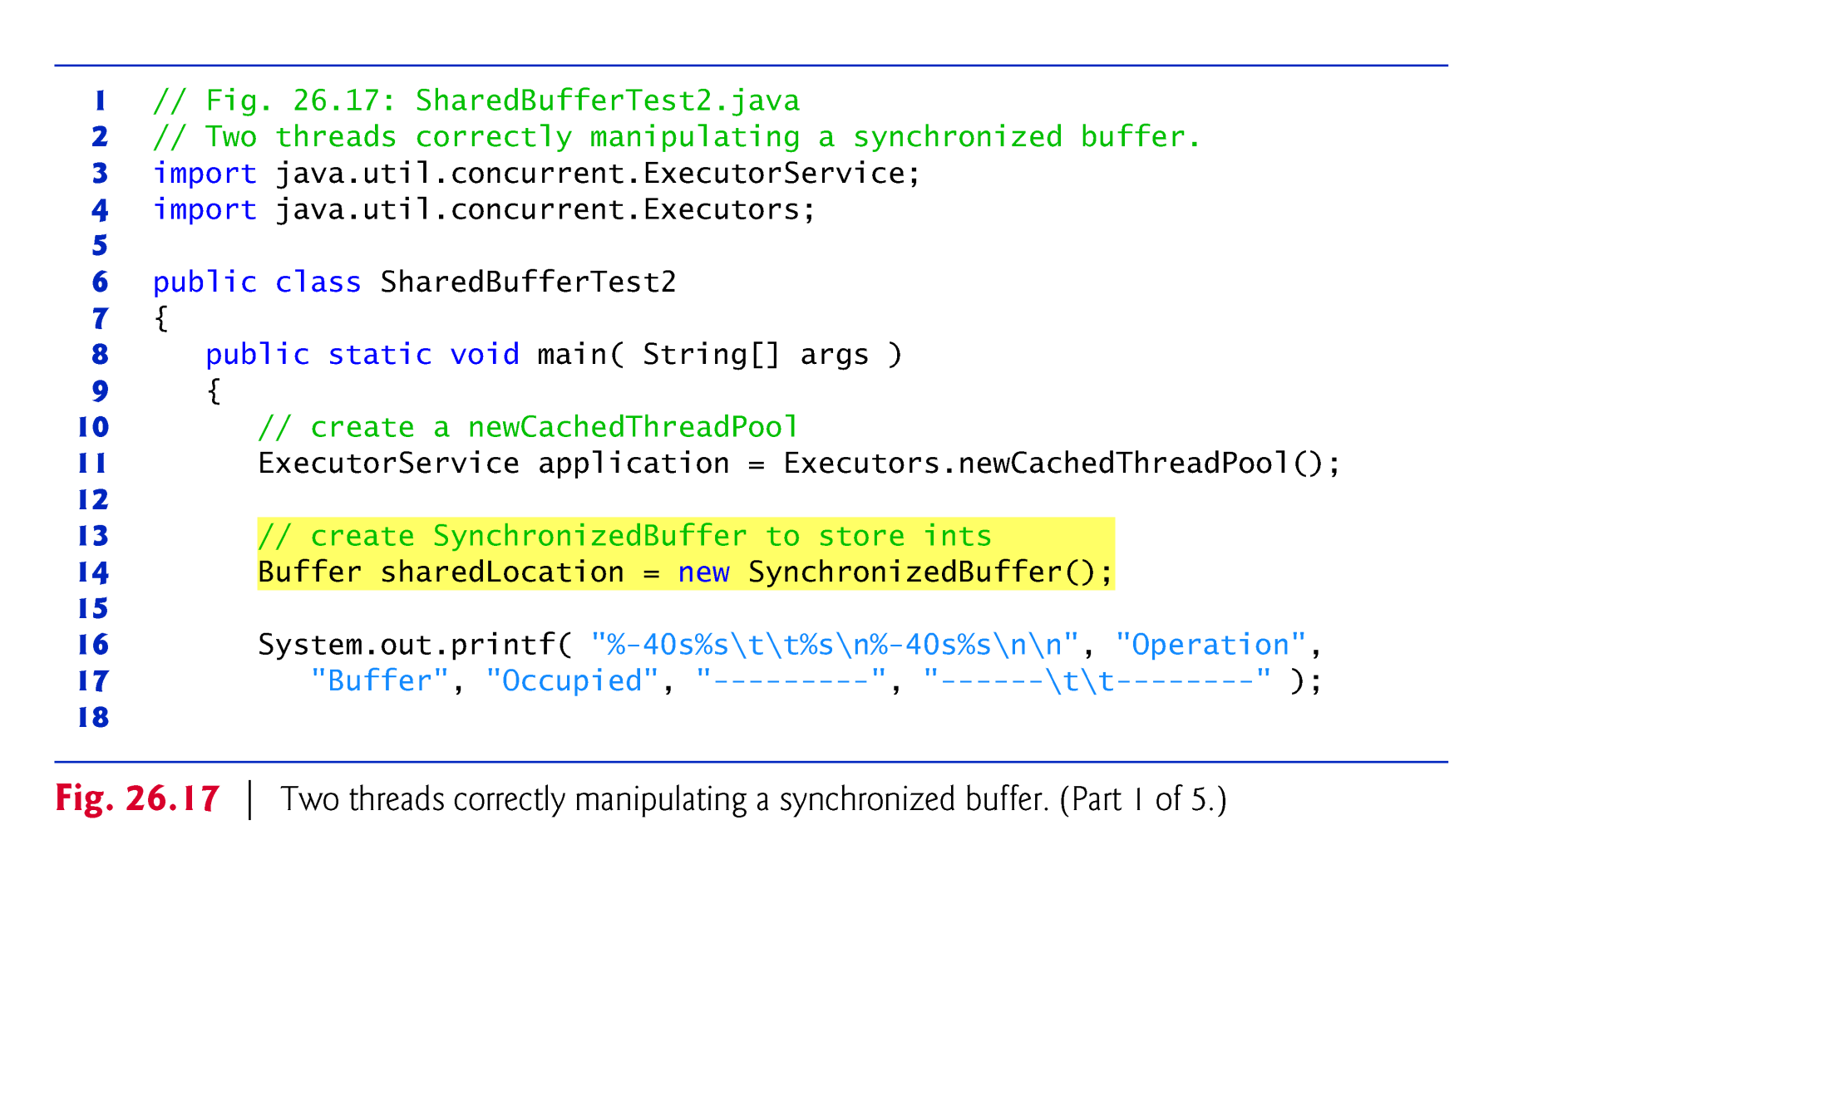

Slide 58
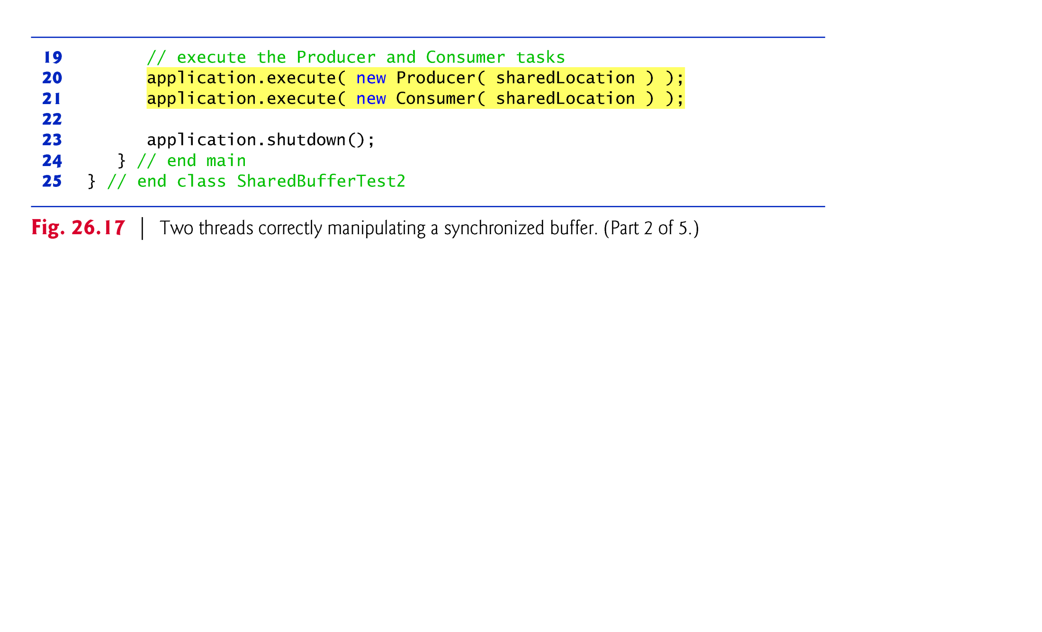

Slide 59
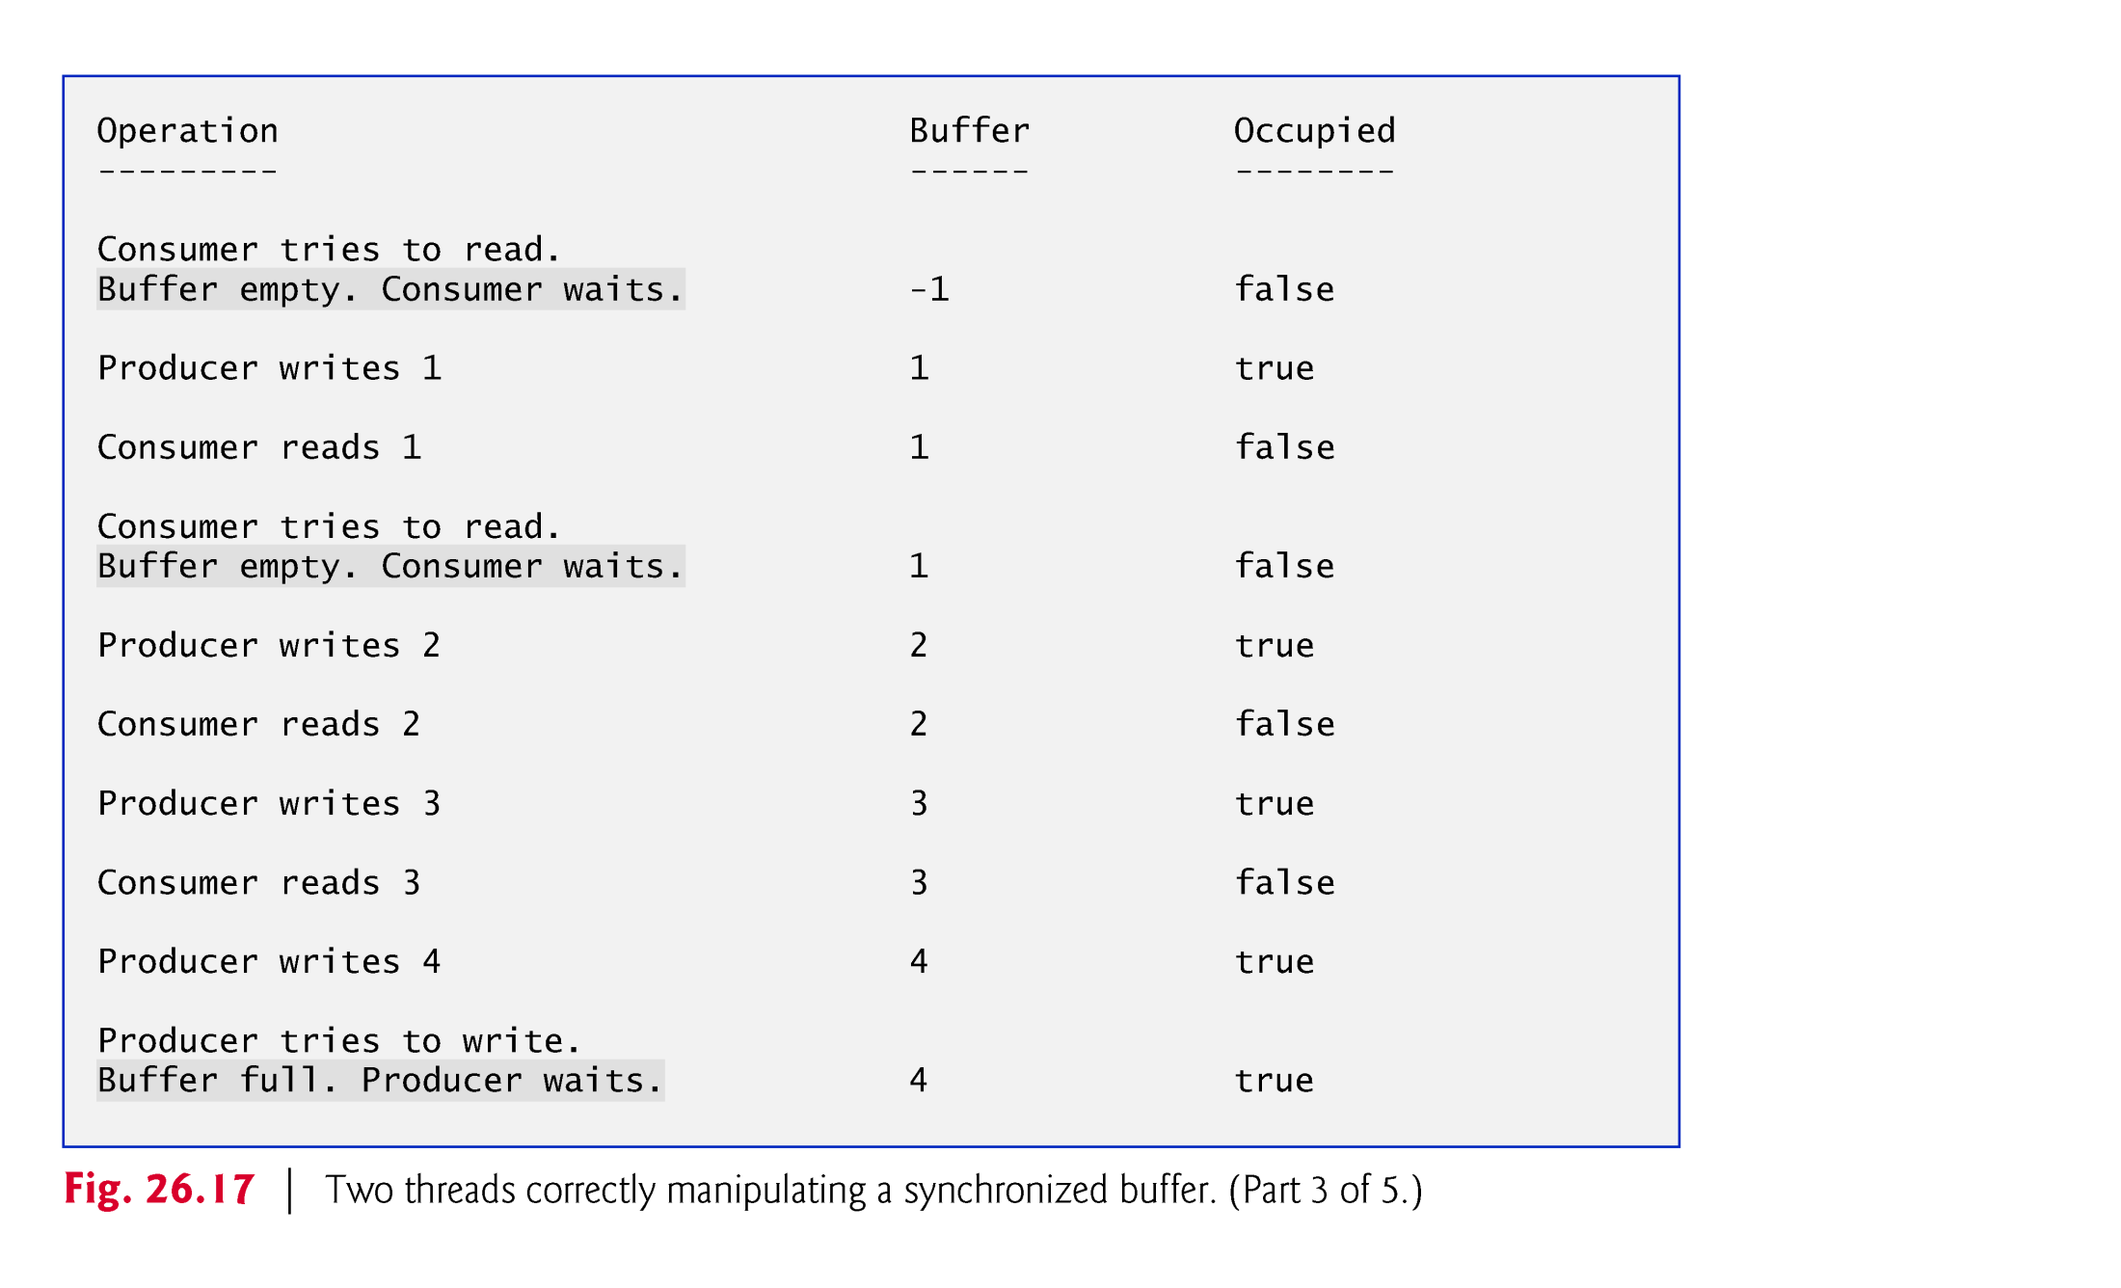

Slide 60
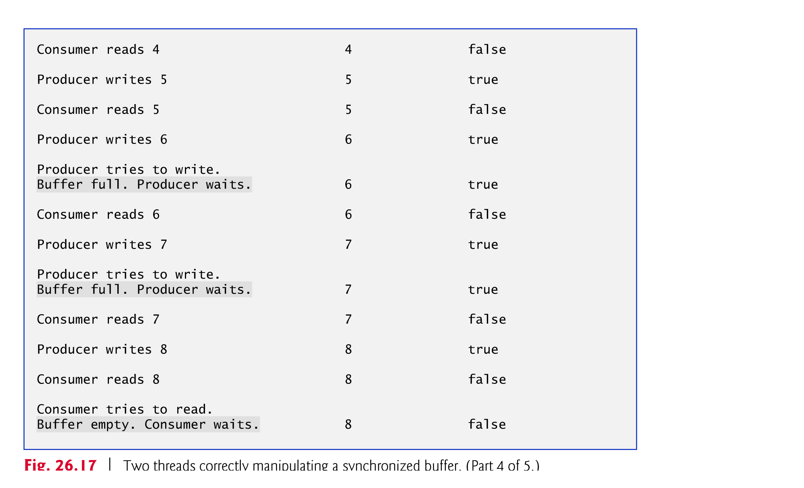

Slide 61
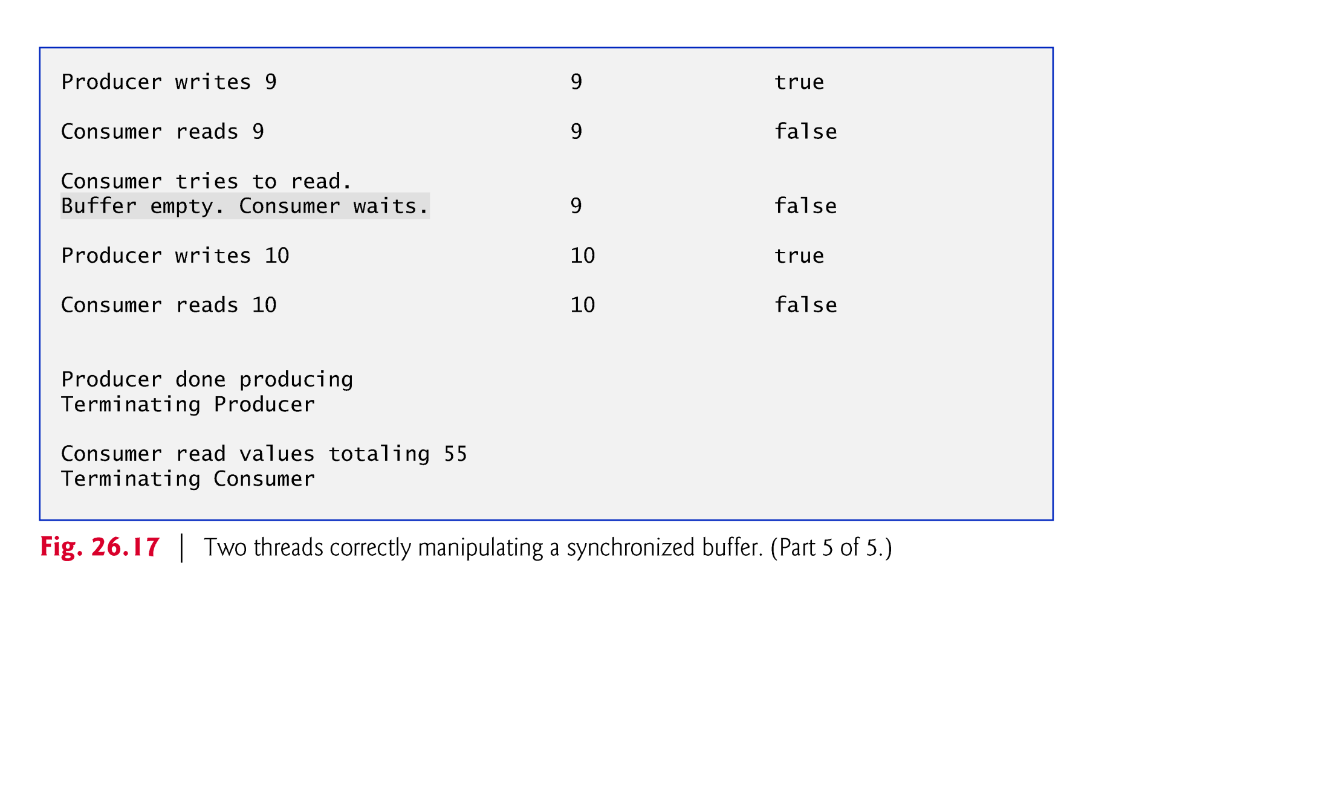

Slide 62
23.8 Producer/Consumer Relationship: Bounded Buffers (cont.)
The simplest way to implement a bounded buffer is to use an ArrayBlockingQueue for the buffer so that all of the synchronization details are handled for you.
This can be done by reusing the example from Section 23.6 and simply passing the desired size for the bounded buffer into the ArrayBlockingQueue constructor.

Slide 63
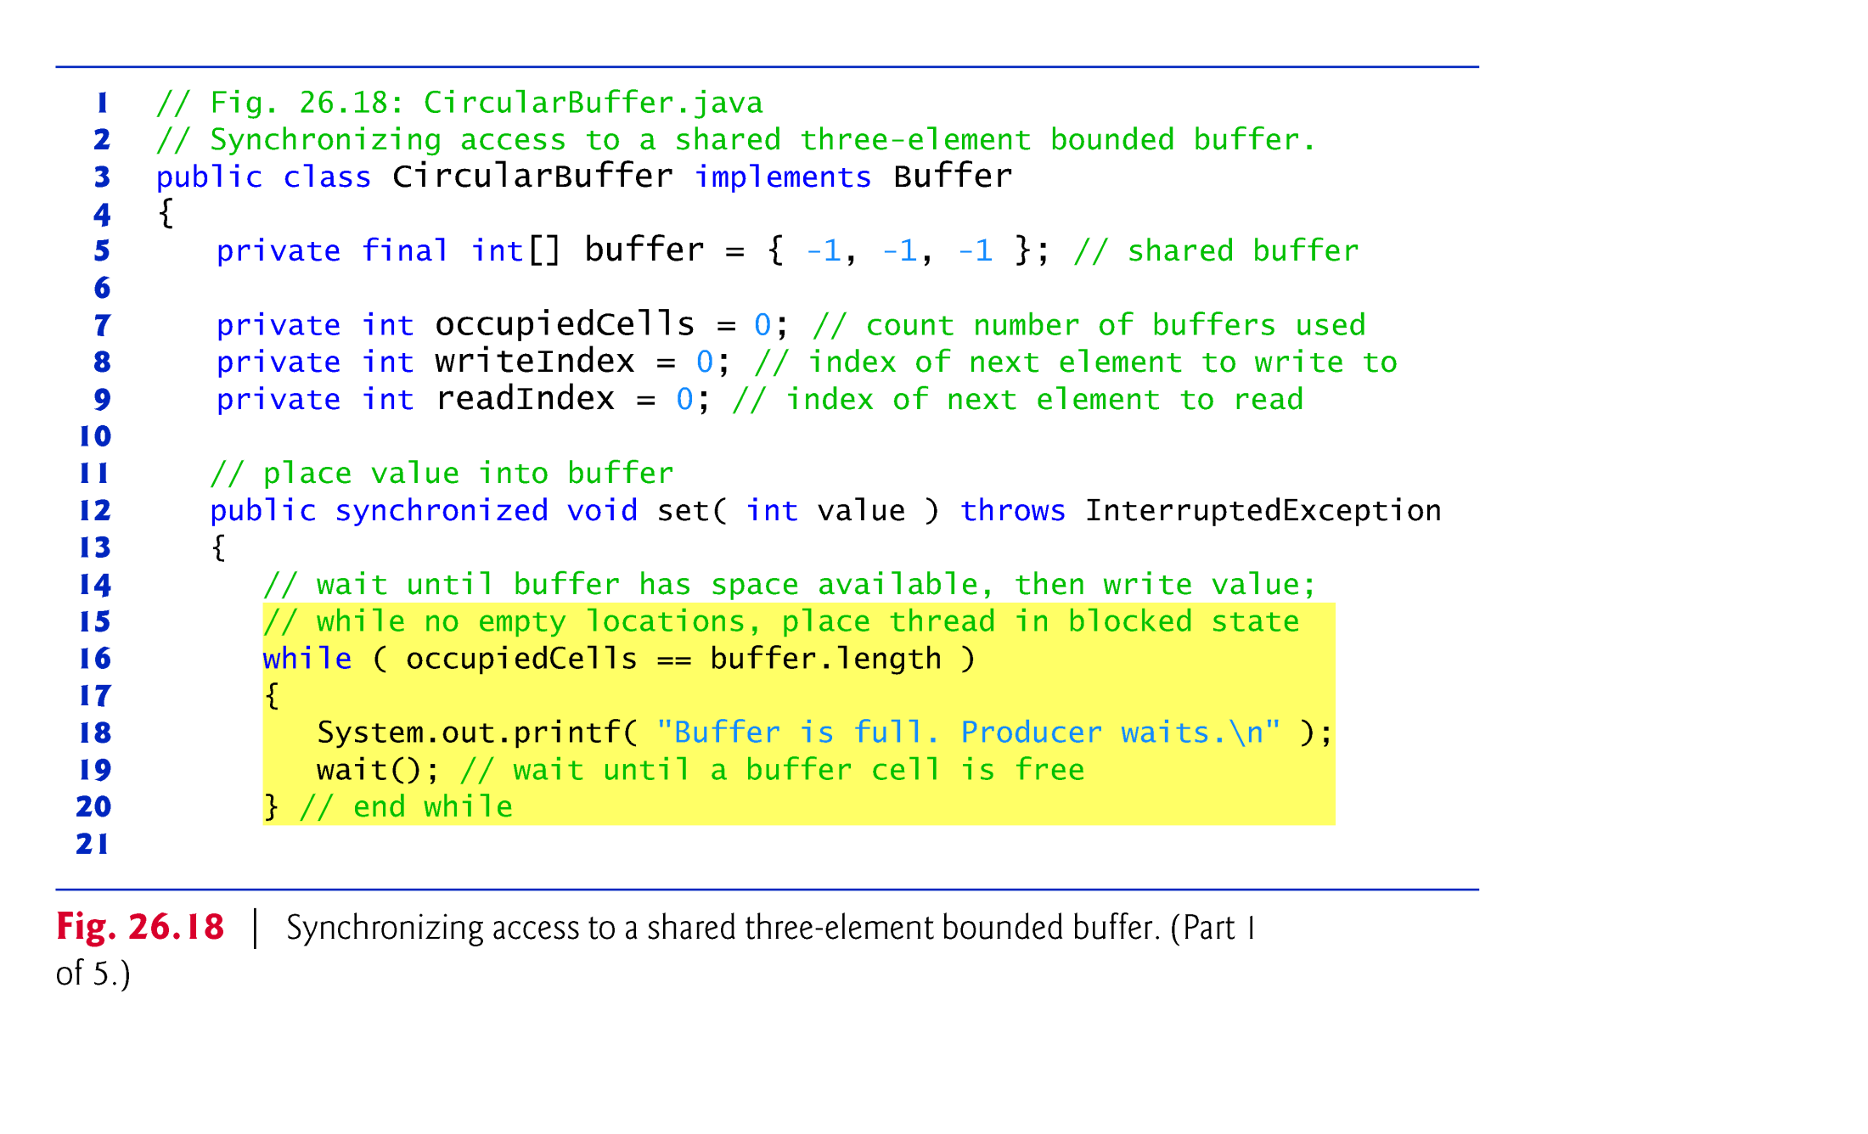

Slide 64
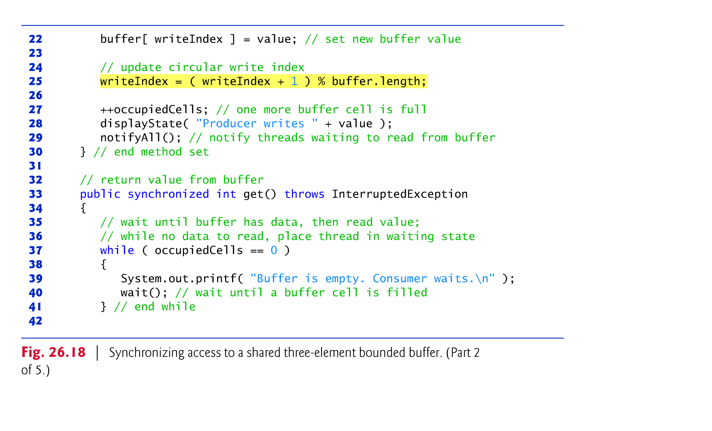

Slide 65
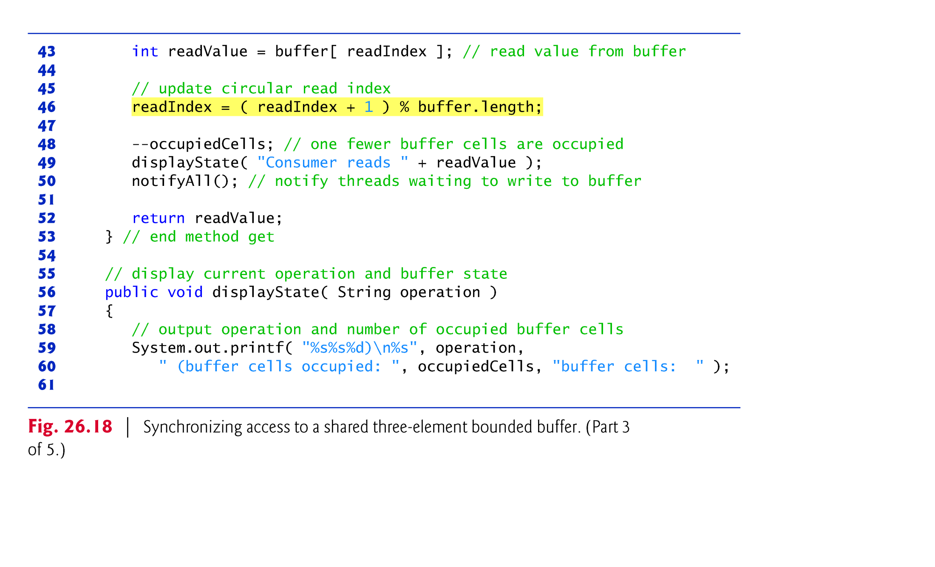

Slide 66
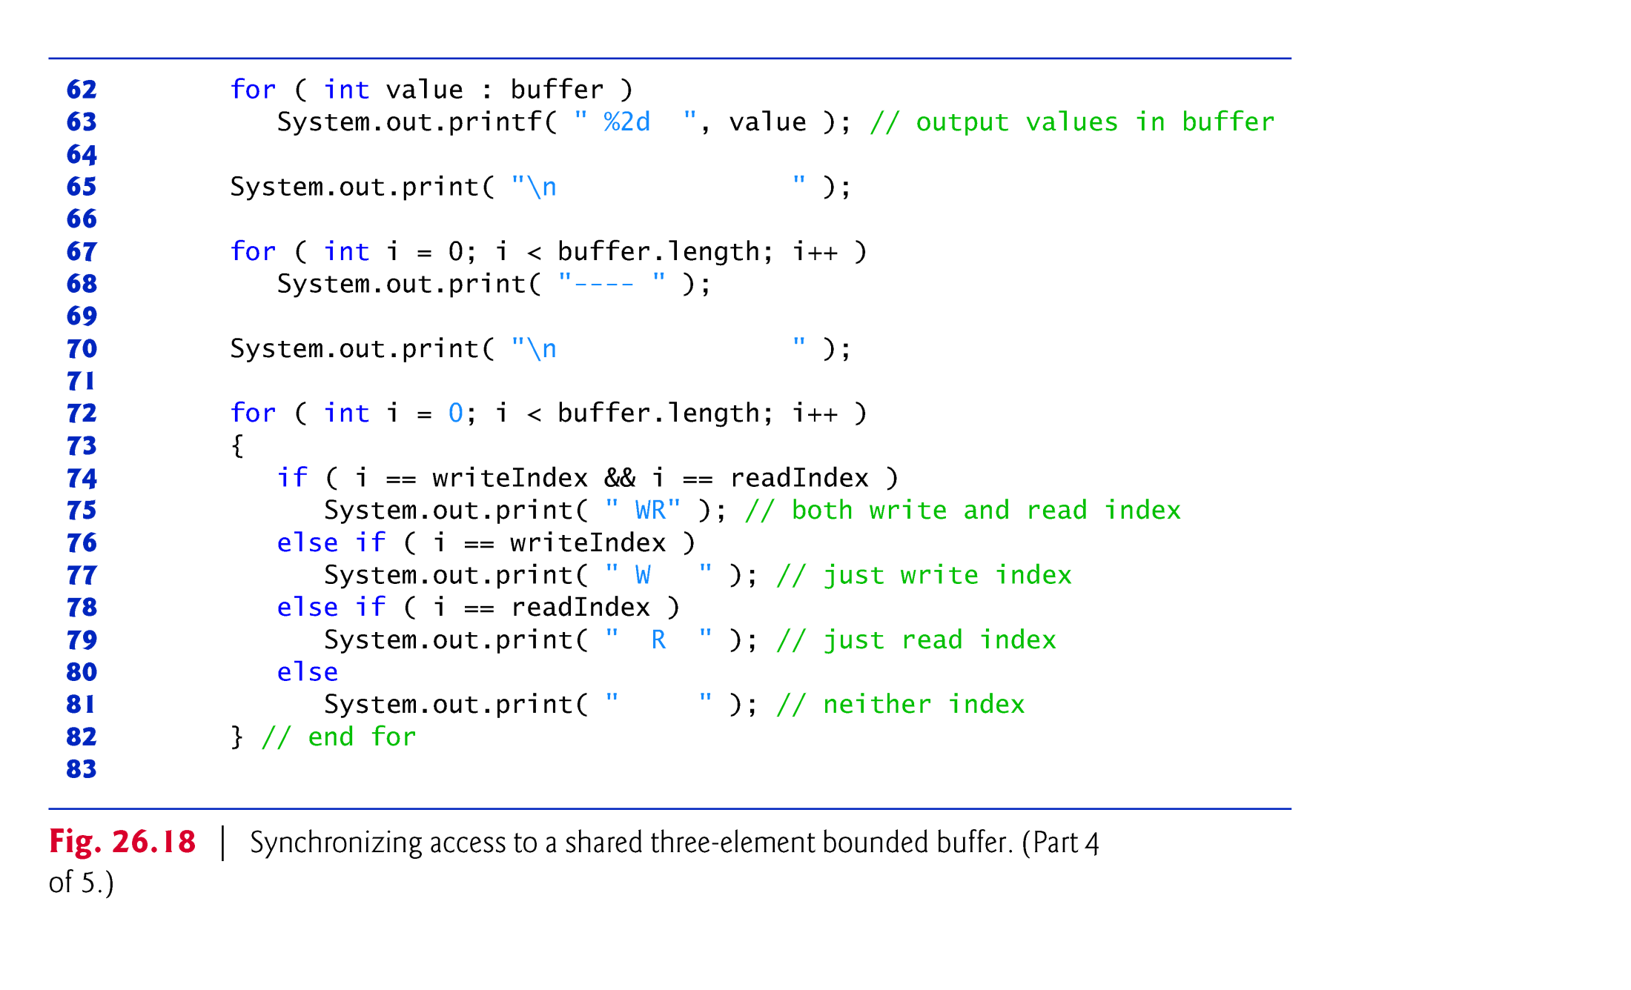

Slide 67
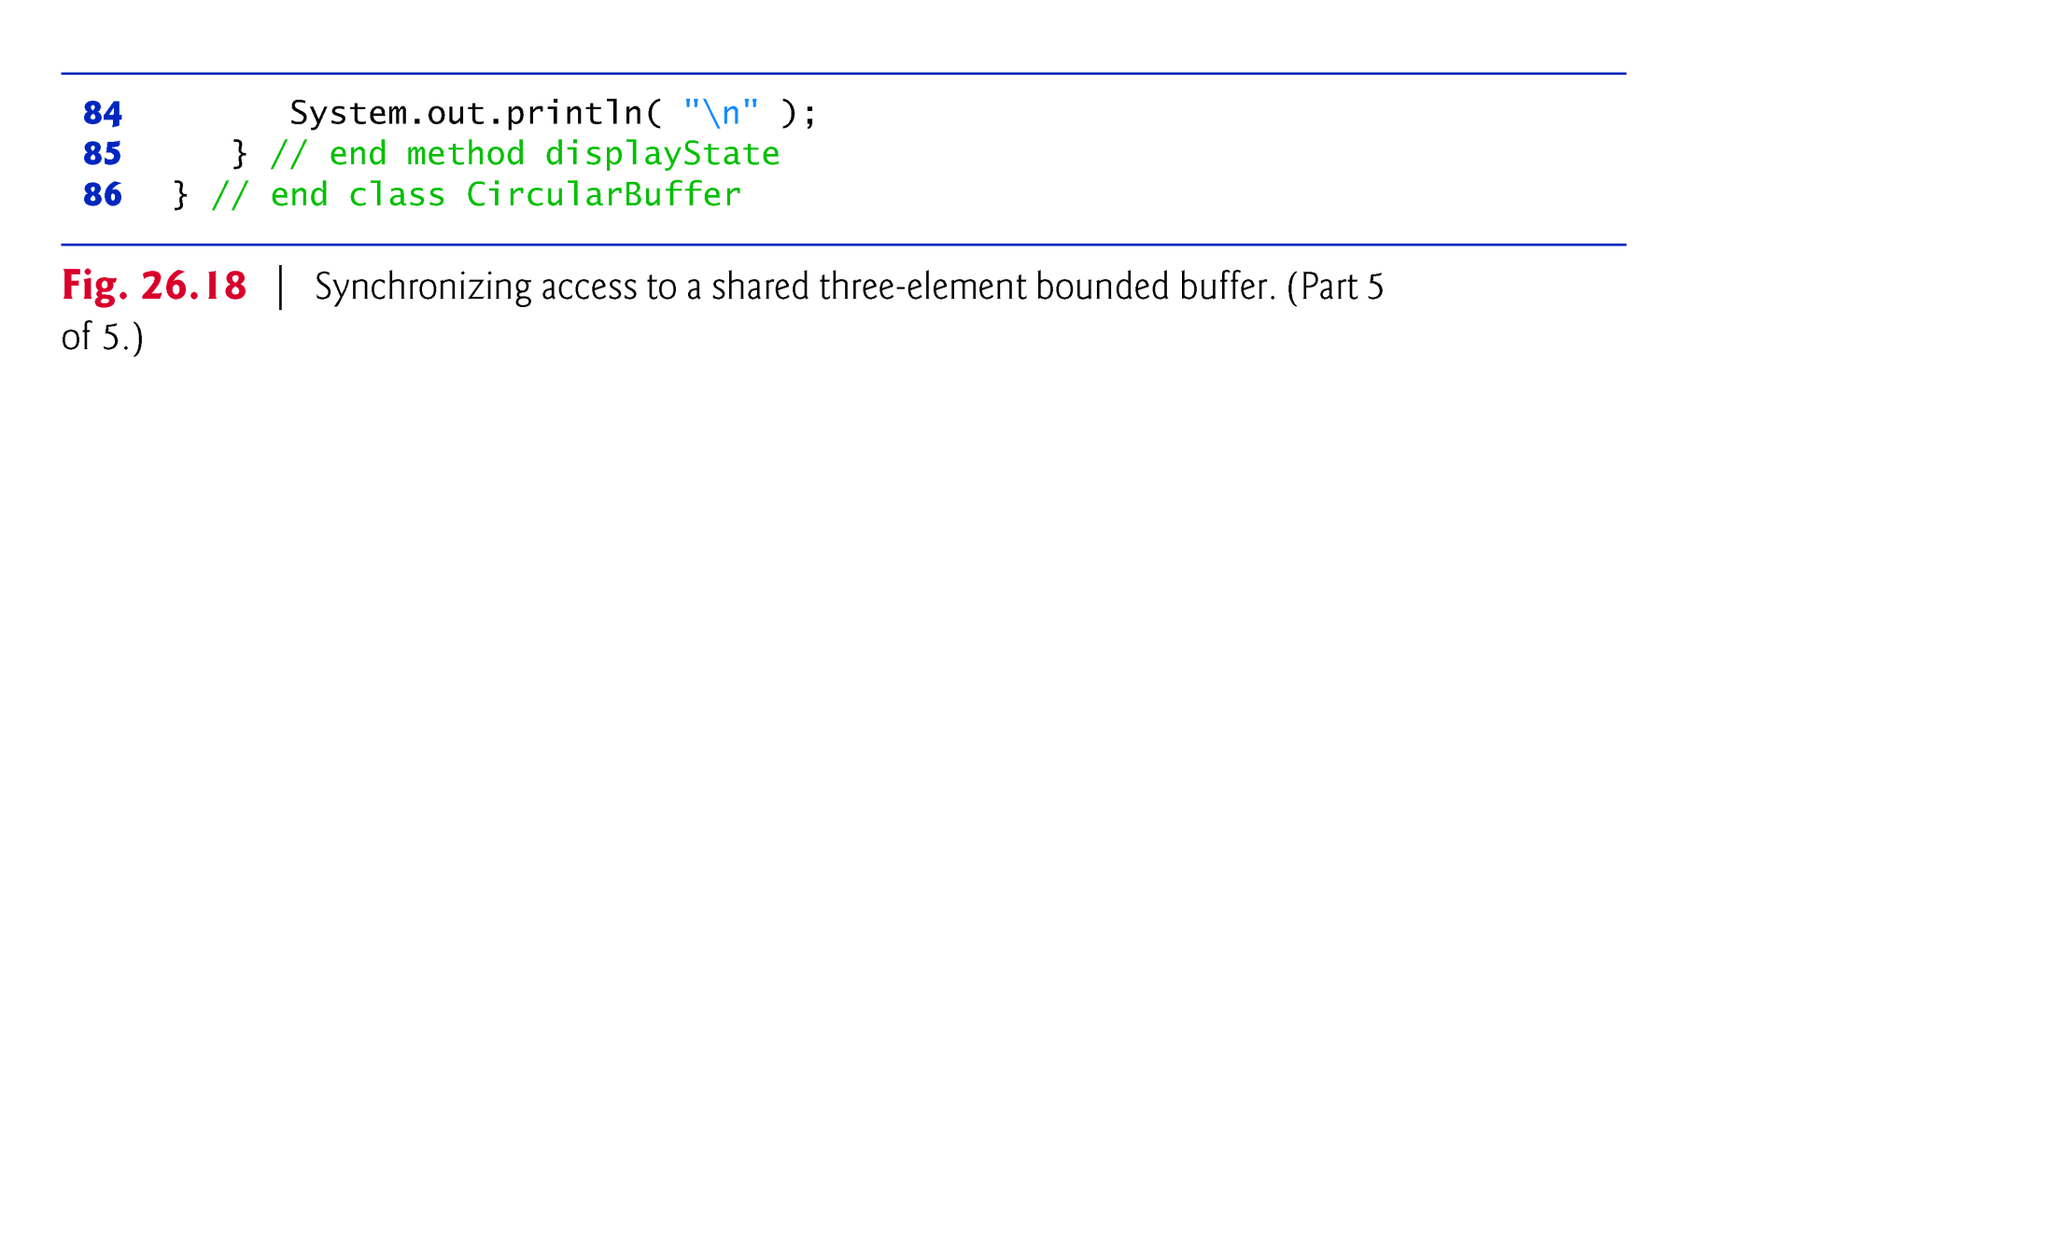

Slide 68
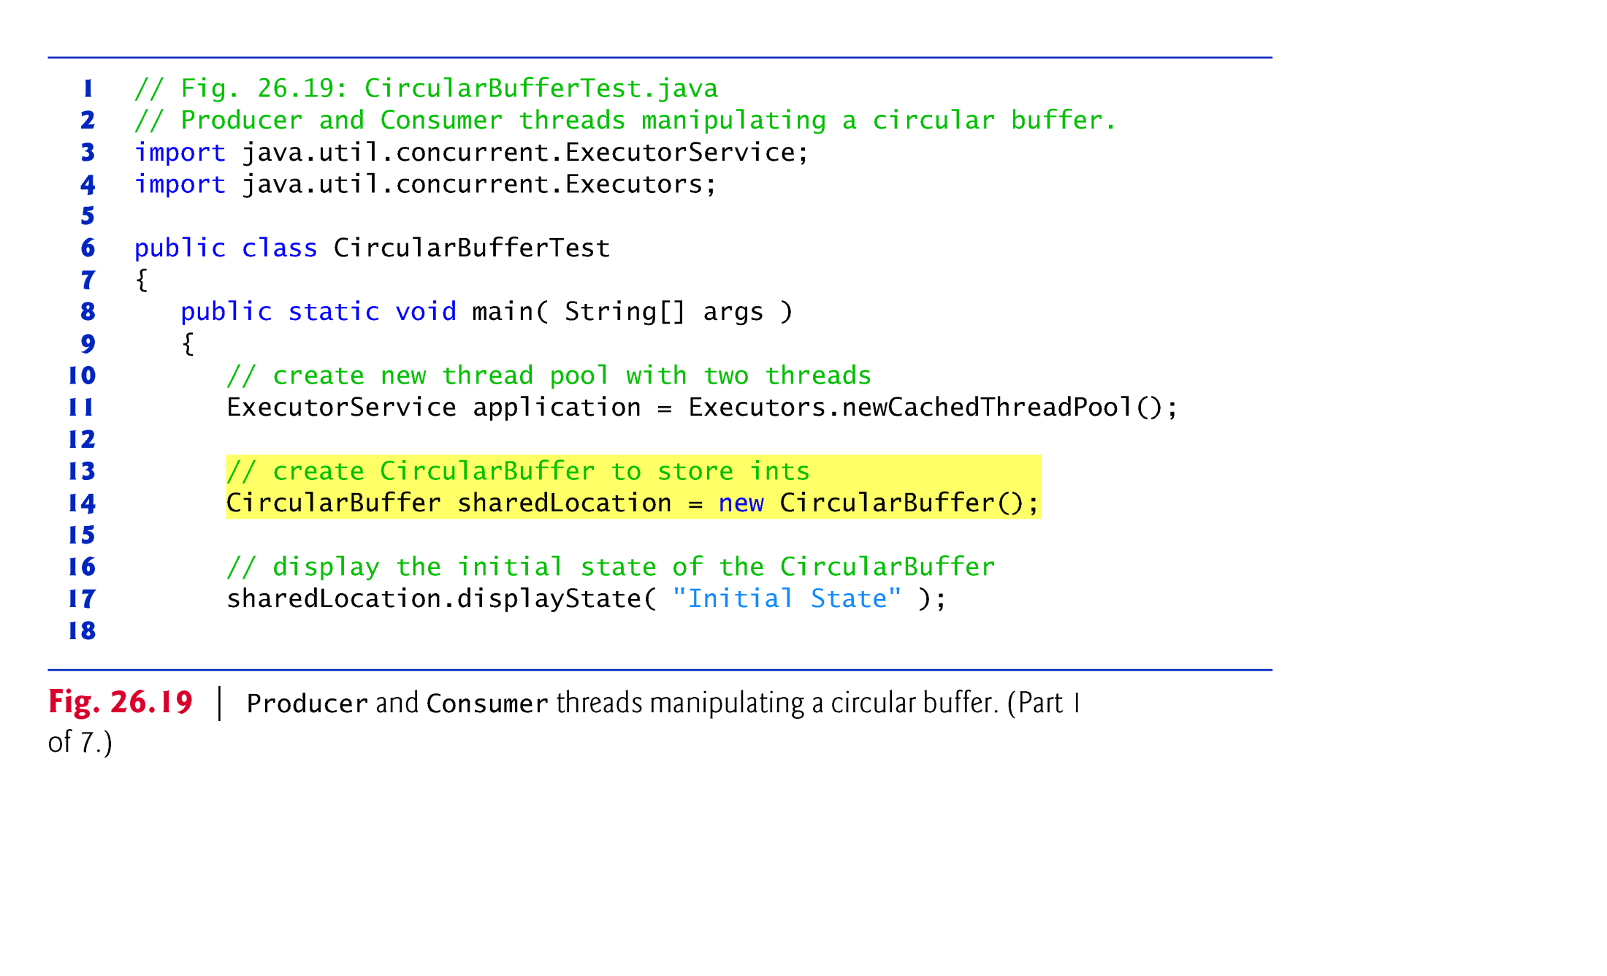

Slide 69


Slide 70


Slide 71


Slide 72


Slide 73


Slide 74


Slide 75
23.9 Producer/Consumer Relationship: The Lock and Condition Interfaces
In this section, we discuss the Lock and Condition interfaces.
These interfaces give you more precise control over thread synchronization, but are more complicated to use.
Any object can contain a reference to an object that implements the Lock interface (of package java.util.concurrent.locks).
A thread calls the Lock’s lock method to acquire the lock.
Once a Lock has been obtained by one thread, the Lock object will not allow another thread to obtain the Lock until the first thread releases the Lock (by calling the Lock’s unlock method).
If several threads are trying to call method lock on the same Lock object at the same time, only one of these threads can obtain the lock—all the others are placed in the waiting state for that lock.

Slide 76
23.9 Producer/Consumer Relationship: The Lock and Condition Interfaces (cont.)
When a thread calls method unlock, the lock on the object is released and a waiting thread attempting to lock the object proceeds.
Class ReentrantLock (of package java.util.concurrent.locks) is a basic implementation of the Lock interface.
The constructor for a ReentrantLock takes a boolean argument that specifies whether the lock has a fairness policy.
If the argument is true, the ReentrantLock’s fairness policy is “the longest-waiting thread will acquire the lock when it’s available.”

Slide 77


Slide 78


Slide 79
23.9 Producer/Consumer Relationship: The Lock and Condition Interfaces (cont.)
If a thread that owns a Lock determines that it cannot continue with its task until some condition is satisfied, the thread can wait on a condition object.
Allows you to explicitly declare the condition objects on which a thread may need to wait.
Condition objects are associated with a specific Lock and are created by calling a Lock’s newCondition method, which returns an object that implements the Condition interface (of package java.util.concurrent.locks).

Slide 80
23.9 Producer/Consumer Relationship: The Lock and Condition Interfaces (cont.)
To wait on a condition object, the thread can call the Condition’s await method.
This immediately releases the associated Lock and places the thread in the waiting state for that Condition.
the runnable thread can call Condition method signal to allow a thread in that Condition’s waiting state to return to the runnable state.
If a thread calls Condition method signalAll, then all the threads waiting for that condition transition to the runnable state and become eligible to reacquire the Lock.

Slide 81


Slide 82


Slide 83


Slide 84
23.9 Producer/Consumer Relationship: The Lock and Condition Interfaces (cont.)
Locks allow you to interrupt waiting threads or to specify a time-out for waiting to acquire a lock, which is not possible using the synchronized keyword.
Also, a Lock is not constrained to be acquired and released in the same block of code.
Condition objects allow you to specify multiple conditions on which threads may wait.
With the synchronized keyword, there is no way to explicitly state the condition on which threads are waiting.
Notes:
lock是可中断锁，而synchronized 不是可中断锁
线程A和B都要获取对象O的锁定，假设A获取了对象O锁，B将等待A释放对O的锁定，
如果使用 synchronized ，如果A不释放，B将一直等下去，不能被中断
如果 使用ReentrantLock，如果A不释放，可以使B在等待了足够长的时间以后，中断等待，而干别的事情
ReentrantLock获取锁定与三种方式： a) lock(), 如果获取了锁立即返回，如果别的线程持有锁，当前线程则一直处于休眠状态，直到获取锁
b) tryLock(), 如果获取了锁立即返回true，如果别的线程正持有锁，立即返回false；
c)tryLock(long timeout,TimeUnit unit)， 如果获取了锁定立即返回true，如果别的线程正持有锁，会等待参数给定的时间，在等待的过程中，如果获取了锁定，就返回true，如果等待超时，返回false；
d) lockInterruptibly:如果获取了锁定立即返回，如果没有获取锁定，当前线程处于休眠状态，直到或者锁定，或者当前线程被别的线程中断

Slide 85


Slide 86


Slide 87


Slide 88


Slide 89


Slide 90


Slide 91


Slide 92

Notes:
可导致无限延迟或死锁

Slide 93


Slide 94


Slide 95


Slide 96


Slide 97
23.10 Concurrent Collections Overview
The collections from the java.util.concurrent package are specifically designed and optimized for use in programs that share collections among multiple threads.

Slide 98


Slide 99

Notes:
vice versa 反之亦然

Slide 100


Slide 101
23.11 Multithreading in JavaFX
All JavaFX applications have a single thread, called the JavaFX application thread, to handle interactions with the application’s controls.
All tasks that require interaction with an application’s GUI are placed in an event queue and are executed sequentially by the JavaFX application thread.

Slide 102
23.11 Multithreading in JavaFX（cont.)
JavaFX’s scene graph is not thread safe—its nodes cannot be manipulated by multiple threads without the risk of incorrect results that might corrupt the scene graph.

Slide 103


Slide 104


Slide 105
23.12 Interfaces Callable and Future
The Callable interface (of package java.util.concurrent) declares a single method named call.
Notes:
Runnable和Callable的区别
(1) Callable规定的方法是 call(), Runnable规定的方法是 run()。
(2) Callable的任务执行后可返回值，而 Runnable的任务是不能返回值。
(3) call方法可以抛出异常， run方法不可以。
(4)运行 Callable任务可以拿到一个 Future对象
Future表示异步计算的结果。它提供了检查计算是否完成的方法，以等待计算的完成，并获取计算的结果。计算完成后只能使用 get方法来获取结果，如果线程没有执行完， Future.get()方法可能会阻塞当前线程的执行；如果线程出现异常， Future.get()会 throws InterruptedException或者 ExecutionException；如果线程已经取消，会跑出 CancellationException。取消由 cancel方法来执行。 isDone确定任务是正常完成还是被取消了。一旦计算完成，就不能再取消计算。如果为了可取消性而使用 Future但又不提供可用的结果，则可以声明 Future <?> 形式类型、并返回null作为底层任务的结果。
（5）我们都知道要自定义一个Thread有两种方法，一是继承Thread，而是实现Runnable接口，这是因为Thread本身就是一个Runnable的实现，所以Runnable可以通过Runnable和之前我们介绍的ExecutorService 来执行，而Callable则只能通过ExecutorService 来执行。
使用runnable
public void executeTask() { ExecutorService executorService = Executors.newSingleThreadExecutor(); Future future = executorService.submit(()->log.info("in runnable!!!!")); executorService.shutdown(); }
使用callable
public void executeTask() { ExecutorService executorService = Executors.newSingleThreadExecutor(); Future future = executorService.submit(()->{ log.info("in callable!!!!"); return "callable"; }); executorService.shutdown(); }
虽然我们都返回了Future，但是runnable的情况下Future将不包含任何值。

Slide 106
23.13 Java SE 7: Fork/Join Framework
Java SE 7’s concurrency APIs include the new fork/join framework, which helps programmers parallelize algorithms.
The fork/join framework is well suited to divide-and-conquer-style algorithms, such as the merge sort in Section 23.3.3.
The fork/join framework can be used to create parallel tasks so that they can be distributed across multiple processors and be truly performed in parallel—the details of assigning the parallel tasks to different processors are handled for you by the framework.
Notes:
它的思想就是将一个大任务分割成若干小任务，最终汇总每个小任务的结果得到这个大任务的结果。
这种思想和MapReduce很像（input --> split --> map --> reduce --> output）

Slide 107


23.14 Java SE 8: Sequential vs. Parallel Streams

Slide 108


Slide 109
Swing component concurrency
Platform.runLater(new Runnable() {
@Override public void run() {
……
}
});
Platform.runLater()->{……}}

